Slide 1
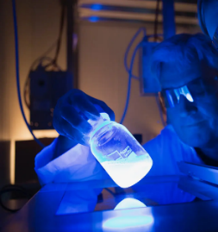
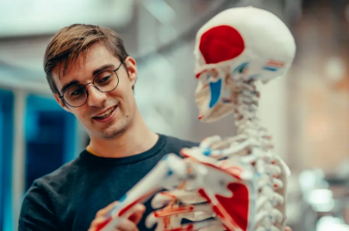
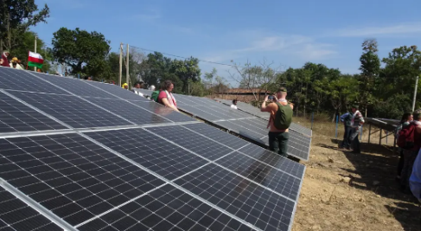
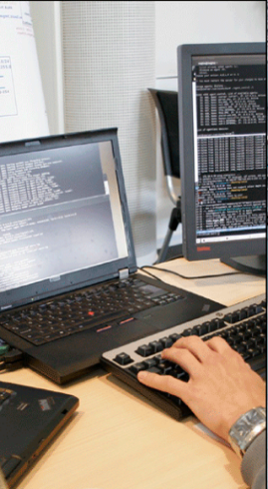

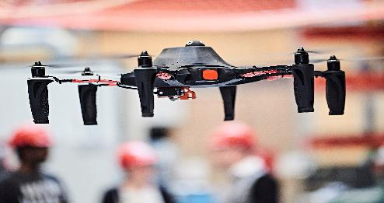

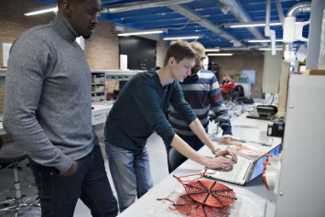
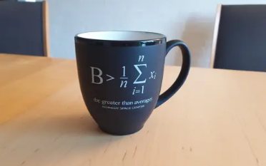
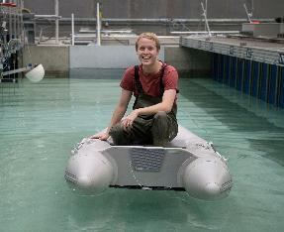
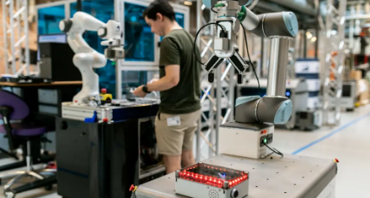
WELCOME TO
MANAGEMENT DAY AT ENGINEERING
10 April 2025
FACULTY OF ENGINEERING AND SCIENCE
Aalborg University

Slide 2
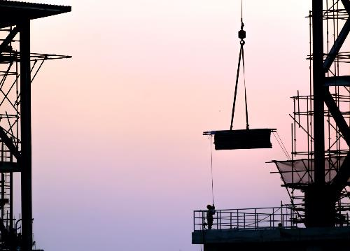

FACULTY OF ENGINEERING AND SCIENCE
At ENGINEERING, we are actively helping to solve some of the major global challenges, especially in the transition to green energy, clean water, sustainable transport and construction, as well as with smart and innovative methods of production for the good of society, the general public and companies. Research, education and knowledge collaboration at ENGINEERING take place in five departments, each with its own core area.
STRENGTHS
Among Europe's best engineering universities
We emphasize collaboration with companies and public sector authorities so that our research creates knowledge for the world
We have a rich study environment with easy access to researchers and research environments, social activities outside the classroom, and a high level of well-being

Slide 3
WORLD-CLASS UNIVERSITY
WITH HIGH RANKINGS
2
ONE OF THE BEST ENGINEERING UNIVERSITIES IN EUROPE
BEST UNIVERSITY
IN EUROPE IN GREEN AND SUSTAINABLE SCIENCE AND TECHNOLOGY
COMPANIES' PREFERRED PARTNER
In green and sustainable science and technology, Aalborg University ranks No. 1 in Europe and No. 26 in the world
U.S. News & World Report,
2024-25
In engineering, Aalborg University is ranked No. 3 among European universities
U.S. News & World Report, 2025-26
AAU takes first place on the Confederation of Danish Industry (DI) list of how satisfied companies are with collaborating with the country's universities
Notes:
Top Electrical and Electronic Engineering Schools in the World – U.S. News & World Report / Education

Slide 4
ENGINEERING – ORGANIZATION
Dean and Vice Deans
Michael Toft Overgaard
Dean
Nis Ovesen
Vice Dean, Education
Kjeld Nielsen
Vice Dean, Research and Innovation
Torsten Nygård Kristensen
Vice Dean, Talent and career development
Dean’s Office
Jacob Glensvang
Head of Secretariat Dean’s Office
Departments
Heads of Department
Doctoral School
Admission Course
Department of
the Built Environment
Kasper Lynge
Head of Department
Torsten Nygård Kristensen
Head of doctoral school
Henrik Brohus
Manager
Occ.health and safety committees
Department of
Materials & Production
Jens Chr. Rauhe
Head of Department
Consultation committees
Department of
Chemistry & Bioscience
Kim Lambertsen Larsen
Head of Department
Faculty Consultation
Committee
Department councils
Department of
Mathematical Sciences
Morten Willatzen
Head of Department
Academic Council
Department of
Energy
Lars Storm Pedersen
Head of Department

Slide 5
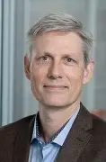
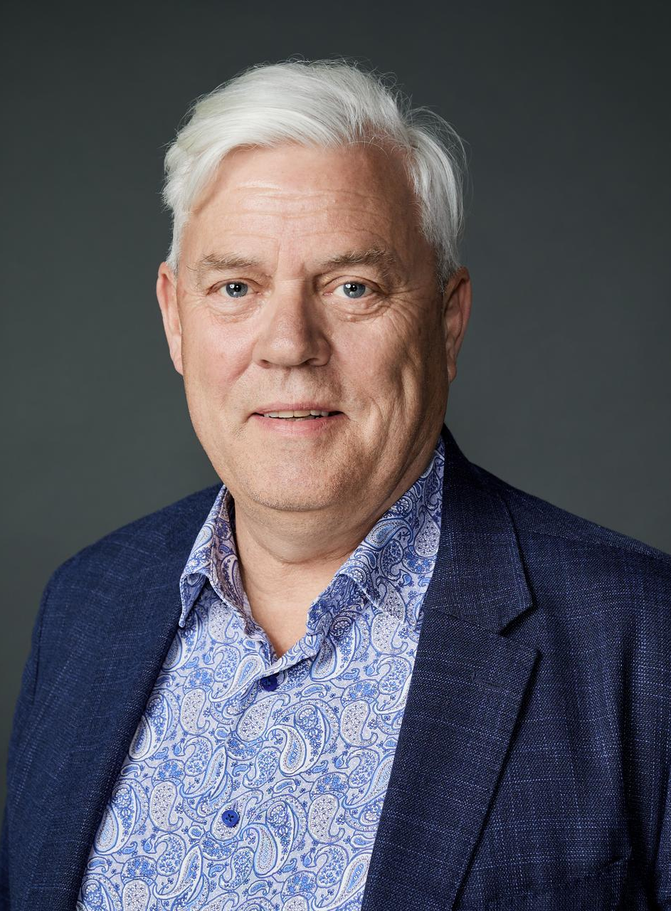
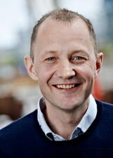







MANAGEMENT AT ENGINEERING
Michael T. Overgaard
Dean
Kjeld Nielsen
Vice Dean
Research and Innovation
Torsten Nygård Kristensen
Vice Dean
Talent and Career development
Nis Ovesen
Vice Dean
Education
Jacob Glensvang
Head of Secretariat
Dean's Office
Kasper Lynge
Head of Department
Built Environment
Jens Chr. Rauhe
Head of Department
Materials and Production
Lars Storm Pedersen
Head of Department
Energy
Morten Willatzen
Head of Department
Mathematical Sciences
Kim Lambertsen Larsen
Head of Department
Chemistry and Bioscience

Slide 6
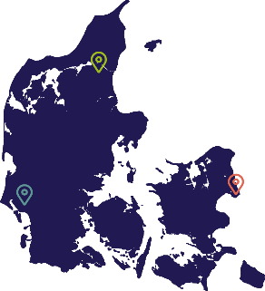

ENGINEERING ON THE NATIONAL MAP
5 DEPARTMENTS:
KEY FIGURES
STAFF MEMBERS
Department of the Built Environment
Department of Materials and Production
Department of Chemistry and Bioscience
Department of Mathematical Sciences
Department of Energy
2,900 students
189 Ph.d. students
57 programmes
3 locations
  Aalborg (1974)
  Esbjerg (1995)
  København (2003)
A total of 1,146 staff members that includes:
418 administrative staff
728 academic staff in research and education, of which 286 are international researchers
Notes:
Figures are from HR, 2026. Keld Sørensen

Slide 7
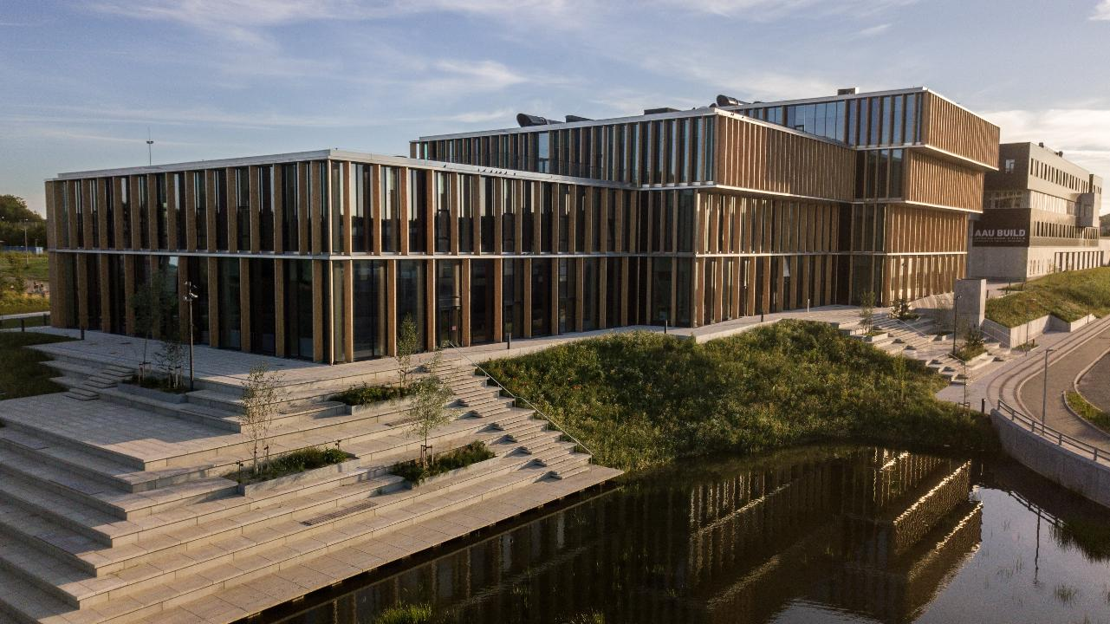
DEPARTMENTS

Slide 8
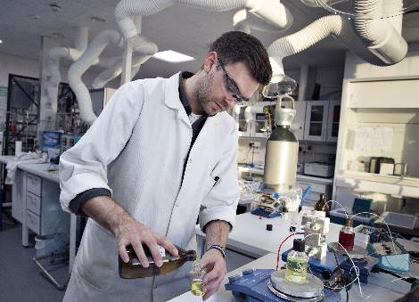
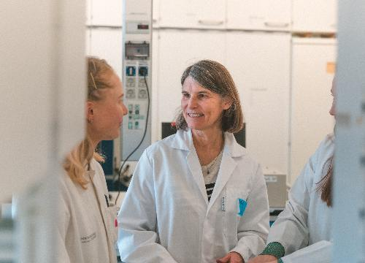
DEPARTMENT OF CHEMISTRY AND BIOSCIENCE
Departments
The department conducts research and offers Bachelor’s, Master’s and PhDs in the fields of biology, chemistry, biotechnology, bioengineering, environmental science and chemical engineering.
The department creates basic and applied knowledge that bridges the gap between engineering and natural science and integrates the latest research into problem-based education in both Aalborg and Esbjerg.
STRENGTHS NOW AND IN THE FUTURE
Biodiversity and biomonitoring
Food and bioprocesses of the future
Functional materials and glass chemistry
Medical biotechnology and diagnostics
Environmental science and microbiology
Technologies for the green transition
Water purification and recycling of resources
SIGNATURE PROJECTS
Microflora Danica: Mapping of all
microorganisms in Denmark
NewGLASS: Predicting the structure of shatterproof glass
Grass4Food: Extraction of feed and food protein from grass
INNO-H2S: Reducing the environmental impact of natural gas extraction
JAMBO: Studying the impact of bottom-dragging fishing gear
The Folbigg Case: Research on calmodulin leads to acquittal
BEYONDBATTREC: Recycling of elements in batteries
RePair: Environmental restoration of Ormstrup Lake at Bjerringbro
GIOS: Infrastructure for climate change research in Greenland

Slide 9
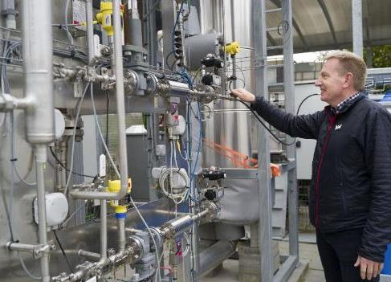
DEPARTMENT OF ENERGY
Departments
The Department of Energy trains students and conducts research in key areas such as energy efficiency, renewable energy, electrification and CO₂ storage. The department plays a crucial role in the green transition where innovation and impact create sustainable solutions for the future.
STRENGTHS NOW AND IN THE FUTURE
Power electronics – component development, reliability, and advanced converter solutions
Smart energy systems – flexibility, sector coupling and intelligent control
Sustainable fuel and biorefinery – P2X, carbon capture, bio-oil and circularity
Electrified and integrated renewable energy systems – stability, offshore and system integration
Digitalization and AI in energy systems – data-driven optimization, fault detection and automation
RESEARCH HIGHLIGHTS
Extensive external funding and numerous awards in power electronics
AAU test facility at the Port of Aalborg for the production of green fuels - a multi-integrated energy system
Pioneering work on flexible energy systems with sector coupling, energy storage and renewable energy control for increased stability
Groundbreaking use of digitalization and AI for smart energy systems with focus on optimization, predictive maintenance, cybersecurity and high operational reliability

Slide 10
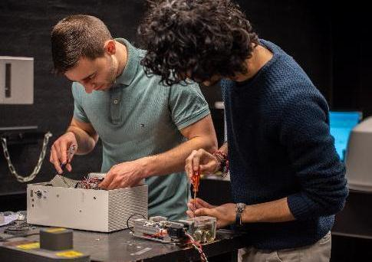
DEPARTMENT OF
MATERIALS
AND PRODUCTION
Departments
The Department of Materials and Production conducts research and trains students in materials, mechanics, physics, production and production management. With this as its starting point, the department strives to develop materials, products and production systems for future needs.
STRENGTHS NOW AND IN THE FUTURE
Circular materials, products, processes and production
Digitalization of production
Exoskeletons, orthopaedic biomechanics
Use of AI for medical purposes and autonomous systems
The green transition, wind energy production, battery technology
RESEARCH HIGHLIGHTS
Contribution to database for 2D materials
like graphene
Understanding cartilage load in osteoarthritis patients
Contribution to supply chain risk management
Classification of exoskeletons for the upper body
Improving materials for lithium-ion batteries and increasing their durability

Slide 11
DEPARTMENT OF THE BUILT ENVIRONMENT
Departments
BUILD conducts research, advises and educates in the areas of urban, residential, construction and facilities. Against this background, the department contributes to solving society's biggest challenges, such as the climate crisis, population development, resource scarcity and urbanization.
STRENGTHS NOW AND IN THE FUTURE
Sustainable construction, including health and indoor climate
Transformation of homes and places, including urban-rural relocation patterns
The city's water and pollution, including sea and coastal structures
RESEARCH HIGHLIGHTS
Development of LCA methods and tools for assessing the climate and environmental impact of construction
Young talented researchers through the eye of the needle for Data.org's "Inclusive Growth and Recovery Challenge" programme
MarinePlastic – BUILD researchers are key players in the interdisciplinary research centre for plastic pollution in the world's oceans

Slide 12

DEPARTMENT OF MATHEMATICAL SCIENCES
Departments
The Department of Mathematical Sciences conducts research and trains students in mathematics, mathematics-technology and mathematics-economics. The department's research contributes to basic scientific discoveries and to solving society's challenges.
STRENGTHS NOW AND IN THE FUTURE
Data Science and AI
Mathematical issues in the maritime area
Spatial statistics
Forensic genetics
Numerical and Mathematical Physics
Topological Data Analysis
RESEARCH HIGHLIGHTS
Grant from the Novo Nordisk Foundation for the project "AI – Aalborg Intelligence" to design courses that use artificial intelligence to make mathematics in high school more exciting
Groundbreaking results on matching of Y-chromosomes
World-leading research on spatial statistics with publications in the highest rated journals in statistics: Annals of Statistics and Journal of the American Statistical Association

Slide 13
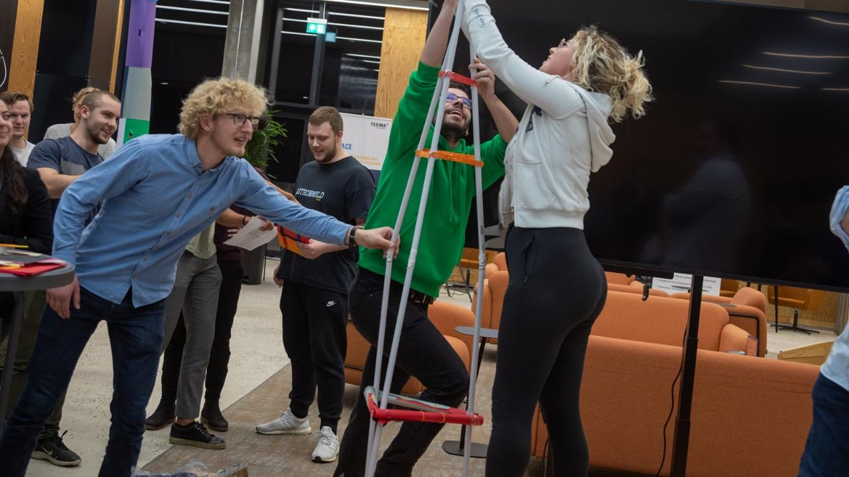
EDUCATION

Slide 14
STUDENTS AT ENGINEERING
2020-2025
Education
Graduates finish
in 5.1 years on average
Notes:
The number of students shows a decreasing trend since 2020. Closed more than we have opened. More students enrolled in the existing degree programmes.
Note: Calculated as of 1/10 2024. Includes ordinary full-time students, visiting students, admission course and part-time programmes
Source: Qlikview / power BI. Number of students Source: : Majken Davids

Slide 15
DROPOUT RATES 1ST YEAR OF STUDY
AS OF 1 MARCH
Education
Targeted measures have yielded results
Focus on study environment and inclusion

Slide 16
LEARNING ENVIRONMENT AT ENGINEERING
Proximity to research environments
Close collaboration with the business community
Challenges are solved in collaboration
A study environment in rapid development

Slide 17
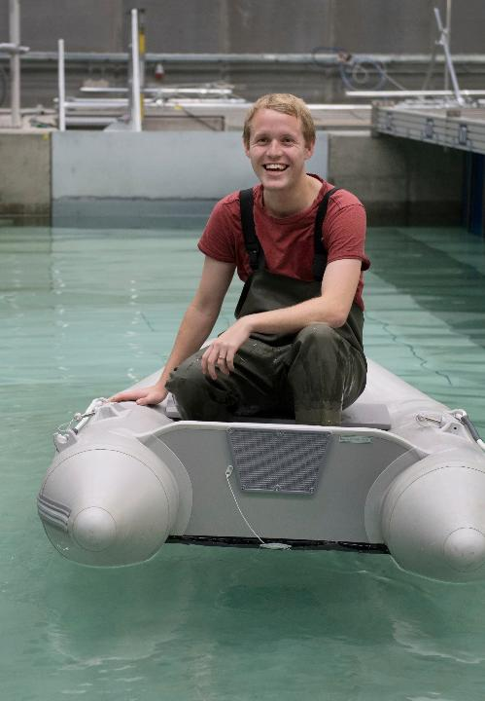


PROBLEM- AND PROJECT-BASED LEARNING (PBL)
Education
Students are driven by a problem and learn through the active application of theory and research-based knowledge in concrete problem solving.
Students are trained to adopt an analytical, result-oriented approach to their work that is also application-oriented through collaboration with external partners.
Students work on projects in groups where they strengthen communication and collaboration skills, among other things. Supervisors assist, challenge, discuss and give feedback along the way.
The work is documented in project reports that are the subject of an oral (group) exam.

Slide 18
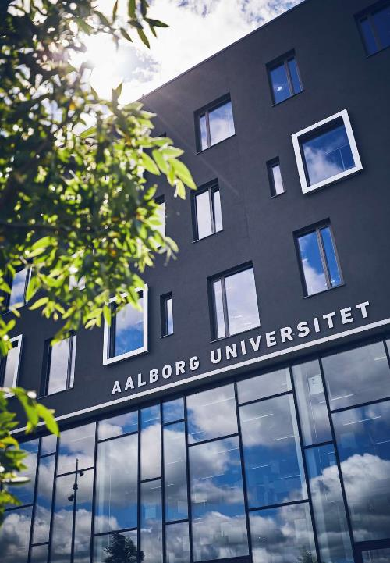
INSTITUTE FOR ADVANCED STUDY IN PBL (IAS PBL)
Education
IAS PBL is a cross-faculty unit that aims to strengthen the quality and development of ​PBL research and practice across AAU.
IAS PBL will serve as a hub for the ongoing development of the Aalborg PBL model in close collaboration with the rest of the ​AAU.
IAS PBL brings together researchers and research groups around pedagogical development.
AAU is home to a UNESCO Center for Problem Based Learning in Engineering Science and Sustainability.

Slide 19
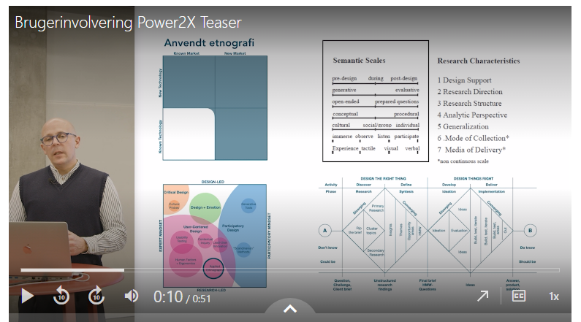
AAU MICRO
Education
As a PBL-focused university, we have special prerequisites for benefiting from digitalization in our degree programmes. We do this with e.g. AAU Micro.
AAU Micro consists of small digital learning units for students across AAU and along the education chain.
AAU Micro supports students' project work on-demand and gives them the opportunity to pursue their own interests.
AAU Micro has the potential to link day programmes with continuing education, including preparing ordinary students for subsequent lifelong learning.
AA Micro shares research-based knowledge to broaden the perspectives of students and teaching staff.

Slide 20
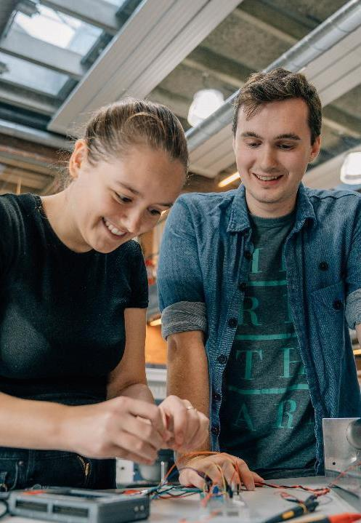
LeadENG
Education
LeadENG projects provide students with unique opportunities for collaboration across fields of study and disciplines.
Through the projects, students gain a special understanding of their own discipline seen in the context of related disciplines.
Collaboration skills and awareness of one's disciplinary expertise are sought-after competencies in the business community as a basis for being able to deliver sustainable and interdisciplinary solutions to society's major challenges.
In 2022, Aalborg University won a gold medal at The QS Reimagine Education Awards across categories as the most innovative education concept in all of Europe.

Slide 21
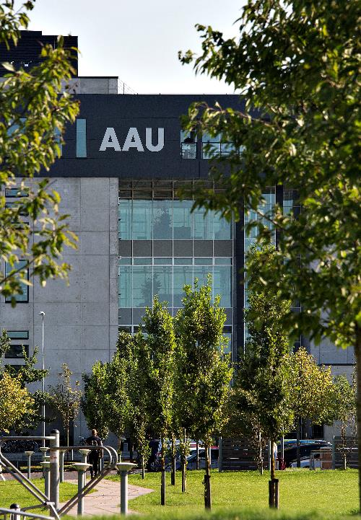
UNEMPLOYMENT AND EMPLOYMENT
Education
In Q4-7 after graduation in 2022, unemployment is low at ENGINEERING. Thus, the latest figures show that unemployment is 4.4%. For AAU overall, unemployment is 9.5%.
Employed graduates from Aalborg University are distributed across the country's regions more so than graduates from the other universities.
On average, more than 60% of AAU graduates find employment in the private sector.
"Partnering with AAU enables us to always be relevant: To constantly have products that tap into the times, so that we can be at the forefront of the market and contribute solutions for the green transition, so that buildings can reduce their energy consumption and primarily use energy at times that put the least possible strain on the energy system." – Henrik Stærmose, CEO, Neogrid, 2025
Notes:
Source: Power BI
Source: DEA report from 2021 (employment)
Based on the number who completed in the period 1 October of the previous year to 30 September of the year. For each who completed, unemployment is measured in the 2nd year after completion (4th-7th quarter). Q4 is defined as the quarter that contains the date exactly 1 year after completion (i.e. Q4-7 is measured from the quarter containing the one-year anniversary of completion up to and including the quarter immediately preceding the two-year anniversary of completion)

Slide 22
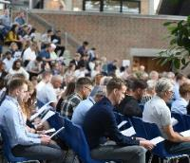
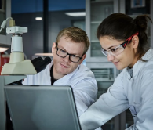
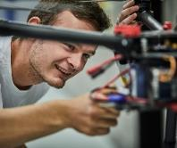
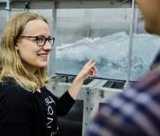
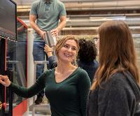
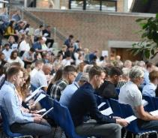
Education
CONTINUING EDUCATION
PROFESSIONAL/EXECUTIVE MASTER’S
AVAILABLE SEATS IN COURSES
FULL-TIME-
PART-TIME
SEPARATE MODULES
FLEXIBLE PROFESSIONAL /EXECUTIVE MASTER’S
SINGLE SUBJECTS
COMPANY-ADAPTED ACTIVITY

Slide 23

RESEARCH

Slide 24
RESEARCH AT ENGINEERING
Research
International
research environments
Interdisciplinary
research
State-of-the-art facilities
Partnerships with
industry & business
Solving societal challenges

Slide 25
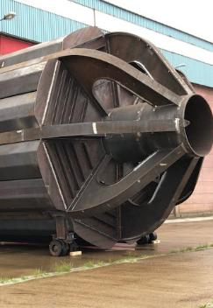
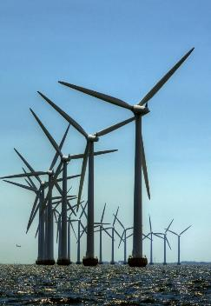
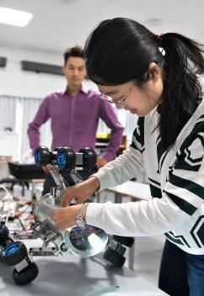
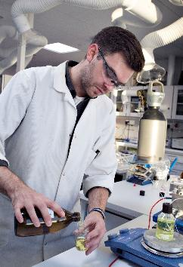
STRATEGIC GOALS
2025-2026
Research
Increase research level
Strengthen innovation level
Increase strategic cooperation
Boost external funding
Update and share infrastructure

Slide 26
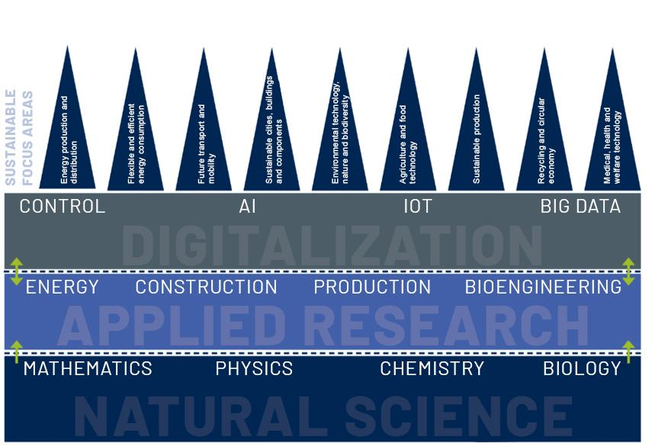
Research
Research and innovation level, collaboration and external funding
Basic
funds
Strategic funds
External funding

Slide 27
Research
SPECIFIC INTERDISCIPLINARY INITIATIVES
AAU PLASTIC
PURPOSE
Interdisciplinary initiatives across departments and faculties align with the strategic goals and contribute to increased collaboration.
AAU BLUE
AAU WATER
AAU WATER
BIO/BUILD/TECH/ENERGY

Slide 28

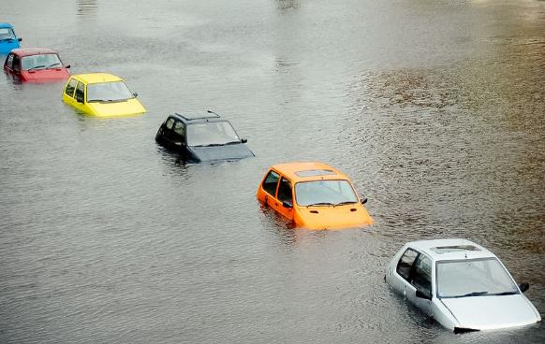
AAU WATER
Research
Societal challenges:
Clean, high-quality drinking water
Water saving, optimized use and circularity
Climate change adaptation
Waste products from wastewater treatment plants
Sector coupling with energy technologies
Robust and reliable water infrastructure
AAU research focus areas:
Wastewater management and water transport
Sensor/IoT, data management and cybersecurity
Water quality and environmental impact
Synergies between water and energy
Biodiversity in aquatic environments

Slide 29
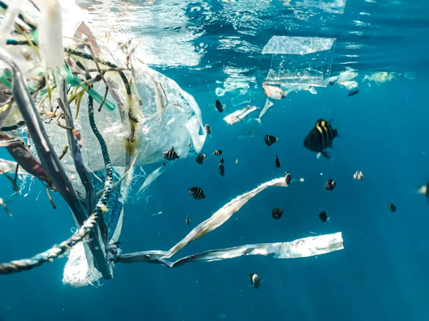

AAU PLASTIC
Research
Societal challenges:
Plastic has become a major environmental problem, especially through the release of micro- and nano-plastics into the environment
Reuse and recycling of plastic is necessary to keep plastic in the circular value chain
AAU research focus areas:
Improve waste management
Promote innovation and exploration of sustainable solutions
Efficient recycling and upcycling of plastics
Mechanical and chemical recycling
Quantification of the smallest plastic particles
Degradation and toxicity of petroleum plastics
Create a circular plastics economy

Slide 30
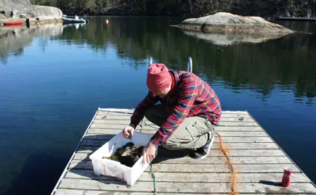

AAU BLUE
Research
Societal challenges:
Sustainable coastal protection and maritime management
Green transition in maritime industries
AAU research focus areas:
Coastal protection and technology
Marine renewable energy sources
Marine ecology and fisheries
Coastal communities and maritime history
Maritime law and governance
Maritime technology and innovation

Slide 31
RESEARCH – KEY FIGURES
Research
DKK Million
Notes:
Source: Dagmar supplies the basic part

Slide 32
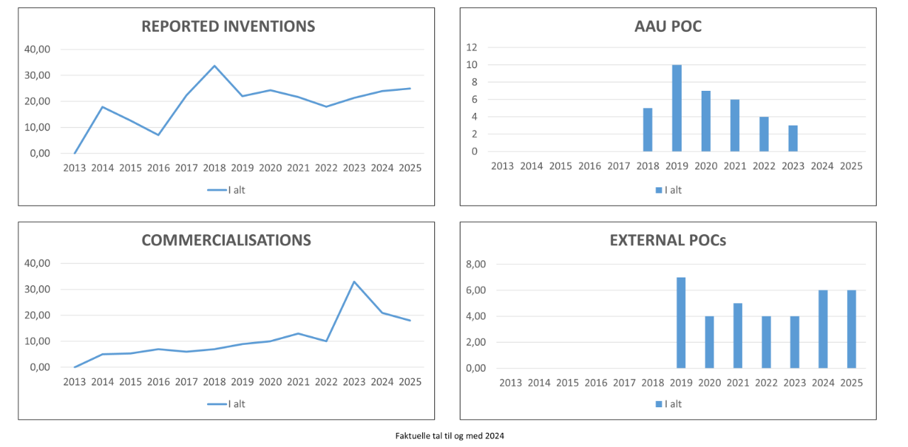
RESEARCH – KEY FIGURES
Research
Notes:
Source: Dagmar supplies the basic part – slides are from JKP

Slide 33
RESEARCH – KEY FIGURES
Research
Notes:
Source: doctoral school (Helen) and VBN (Poul Melchior)

Slide 34

KNOWLEDGE COLLABORATION

Slide 35
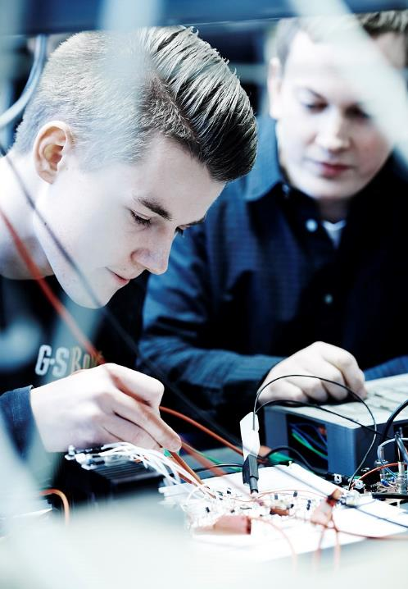
TRADITION OF COLLABORATION
Collaboration
AAU's problem-based research and learning model creates innovative solutions to real-world societal challenges through collaboration between students, researchers and external partners.
Science is conducted in close collaboration with the business community and public partners.
An AAU culture that supports the dynamism and drive of students and staff.
Strong focus on developing new ways of supporting knowledge collaboration.

Slide 36
STRONG COLLABORATION SKILLS
Collaboration
COMMERCIAL PORTFOLIO
FLEXIBLE APPROACH TO COLLABORATION
BEST FOR RESEARCH AGREEMENTS
AAU is in the top 3 in terms of active options, license and sales agreements.
Research-intensive companies consider AAU to be the best Danish university at handling the process from patent to commercialization.
In 2025, 511 research agreements were established between public/private actors and AAU. This puts AAU in 3rd place among the Danish universities.
Notes:
FLEXIBLE APPROACH TO COLLABORATION
Source: Confederation of Danish Industry, Analysis (2016): Knaster i samarbejde om forskning – men også positive tendenser [Hurdles in research collaboration - as well as positive trends].
BEST FOR RESEARCH AGREEMENTS AND COMMERCIAL PORTFOLIO
Source: Ministry of Higher Education and Science Commercialization statistics — Ministry of Higher Education and Science data warehouse

Slide 37
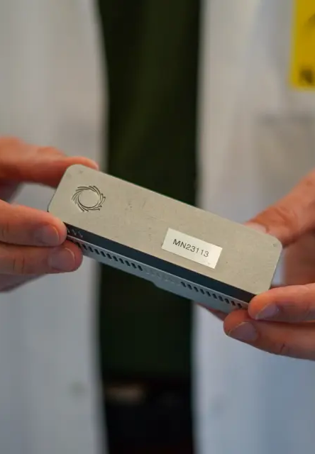
KNOWLEDGE COLLABORATION
– BINDING, FOCUSED, MUTUAL
Collaboration
Cluster partnerships
Entrepreneurship
SME partnerships
Strategic partnerships
Industrial PhDs, postdocs, 20% professors, etc.
Student collaboration (projects, internships, student jobs)
Research collaboration with 3rd party funding
Use of facilities and equipment

Slide 38
CREATING VALUE IN SOCIETY
Collaboration
COMPETITIVENESS
STRENGTHENED
PRODUCTIVITY
GROWS
STRENGTHENED
INNOVATION CULTURE
More than 75% of companies indicate that collaboration with AAU has contributed, to a high or some extent, to strengthening their competitiveness in one or more areas.
Company productivity grows 12% on average when collaborating with AAU
More than 90% of public sector partners state that they gained new inspiration and professional competences, to a high or some extent, after collaborating with AAU.
Notes:
COMPETITIVENESS STRENGTHENED
Source: Iris Group (2021): Fra viden til samfundsnytte - Aalborg Universitets bidrag til innovation, iværksætteri og grøn omstilling [From knowledge to societal benefit - Aalborg University's contribution to innovation, entrepreneurship and the green transition]
PRODUCTIVITY GROWS
The productivity of the companies grows 12% on average, over a period of 8 years, when collaborating with AAU.
Source: Iris Group (2021): Fra viden til samfundsnytte - Aalborg Universitets bidrag til innovation, iværksætteri og grøn omstilling [From knowledge to societal benefit - Aalborg University's contribution to innovation, entrepreneurship and the green transition]
STRENGTHENED INNOVATION CULTURE
Public organisations also benefit significantly from their collaboration with Aalborg University.
Annually, Aalborg University enters into 400-500 collaboration agreements with public organisations.
Source: IrisGroup (2017): Aalborg Universitets vidensamarbejde – effekter for virksomheder, myndigheder og samfund [Aalborg University’s knowledge collaboration – effects for companies, public authorities and the society]

Slide 39

INNOVATION AND ENTREPRENEURSHIP
Collaboration
AAU works strategically on entrepreneurship for students and researchers.
AAU Science and Innovation Hub has become a
hub for interdisciplinary innovation.
Incubator scheme
Venture Cup – Startup Competition
Venture Cup – Idea Competition
Spin In
Workshops
Wofie
Entrepreneurship and innovation courses integrated in curricula
Solution Camp
Business Booth
Drop-in advice for entrepreneurs, regardless of the step they are on.
Notes:
Aalborg University offers a number of courses and workshops in innovation and entrepreneurship. One step naturally leads to the next, and we are here to give students the best opportunities all along the way.
For more details: www.sea.aau.dk
Innovation and entrepreneurship are prioritized strategic initiatives at AAU, and initiatives are developed that take into account that students are at various levels both in their interests and development in terms of their business ideas.
The early initiatives are primarily about stimulating the students' desire and motivation for innovation, and an opportunity to give them experience in working on idea generation, innovation, business development, and presentation skills.
In addition, work is very much extracurricular, with initiatives that aim to develop the business ideas the students come with, and ensure that students get an opportunity to test their entrepreneurial potential through workshops, collaboration with established companies, mentors and business developers. In addition, AAU takes part in the national business plan competition for universities: Venture Cup.

Slide 40
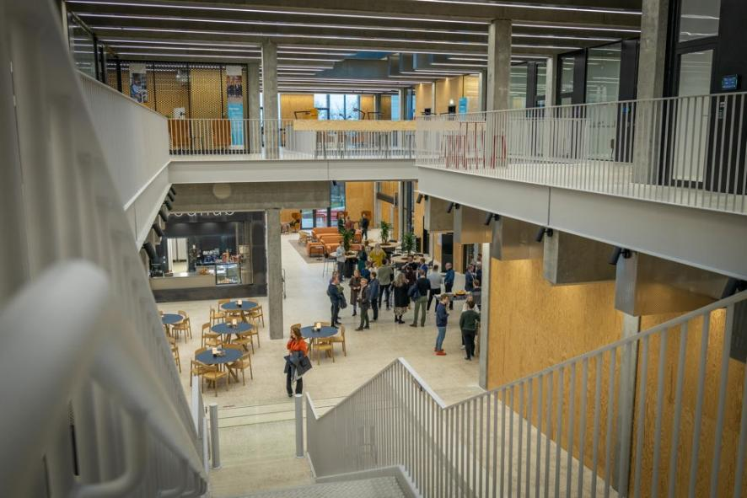
AAU INNOVATE
Collaboration
TALENT AND BUSINESS DEVELOPMENT
INTER-
DISCIPLINARY RESEARCH
WORKSHOPS
AND PROTOTYPING LABS
INCUBATOR ENVIRONMENT FOR STUDENTS /
EARLY-CAREER RESEARCHERS
Notes:
AAU Science & Innovation Hub is a major strategic initiative in research and innovation.
The building is centrally located on the Aalborg East campus. The project was completed in 2022.
The AAU Science & Innovation Hub serves as a state-of-the-art centre providing the optimum physical environment for interdisciplinary research – not least as a place for researchers and companies to collaborate on solving major societal challenges relating to sustainability, climate change, IT security and demographic changes.
The new building brings together the university’s incubator environments for students and early-career researchers in one location to provide them opportunity of being part of a community with established companies and researchers.
Laboratory facilities where companies and students have experimented and tested ideas were set up with a view to creating new entrepreneurs or growing small and medium-sized enterprises through innovation and new ways of thinking.
The building is equipped with workshops, prototyping laboratories and other such innovative facilities.
There are already many initiatives aimed at strengthening collaboration between researchers and partners across Aalborg University. But we want more to happen.
AAU INNOVATE will be a place where everyone can meet, mature ideas and be together to create new synergies. The ambitions are high, and the goals are clear:
1.We put entrepreneurship and entrepreneurship on the agenda. It is crucial that the knowledge created at the university is put to use in society. We ensure this by creating an open and common field of interest for all parties and by giving students and researchers more competencies in entrepreneurship.
2. We provide mission-oriented, interdisciplinary research and education. The world needs us to relate to each other in critical, committed and constructive ways. AAU INNOVATE breaks down traditional research barriers and enables interaction across knowledge and disciplines — and facilitates solutions to real-life problems.
3. We are developing an attractive innovation environment for researchers, students and collaboration partners. AAU INNOVATE will be an inspiring gathering point for students, researchers, companies, investors and startups, and thus motivate cross-cutting activities and collaboration with a sharp focus on sustainable change.
4. We raise the bar for physical and digital collaboration with the world around us. By virtue of its architecture alone, AAU INNOVATE will inspire new and different collaborations. We will also make use of the many opportunities of digitalization and create new, effective ways of communicating. The building’s physical framework will also be increasingly reflected digitally.
With support from the A.P. Møller Foundation, AAU is home to a significant new building called AAU Science & Innovation Hub.
The total budget for the construction was DKK 200 million; AAU financed DKK 100 million and the A.P. Møller Foundation donated DKK 100 million.

Slide 41
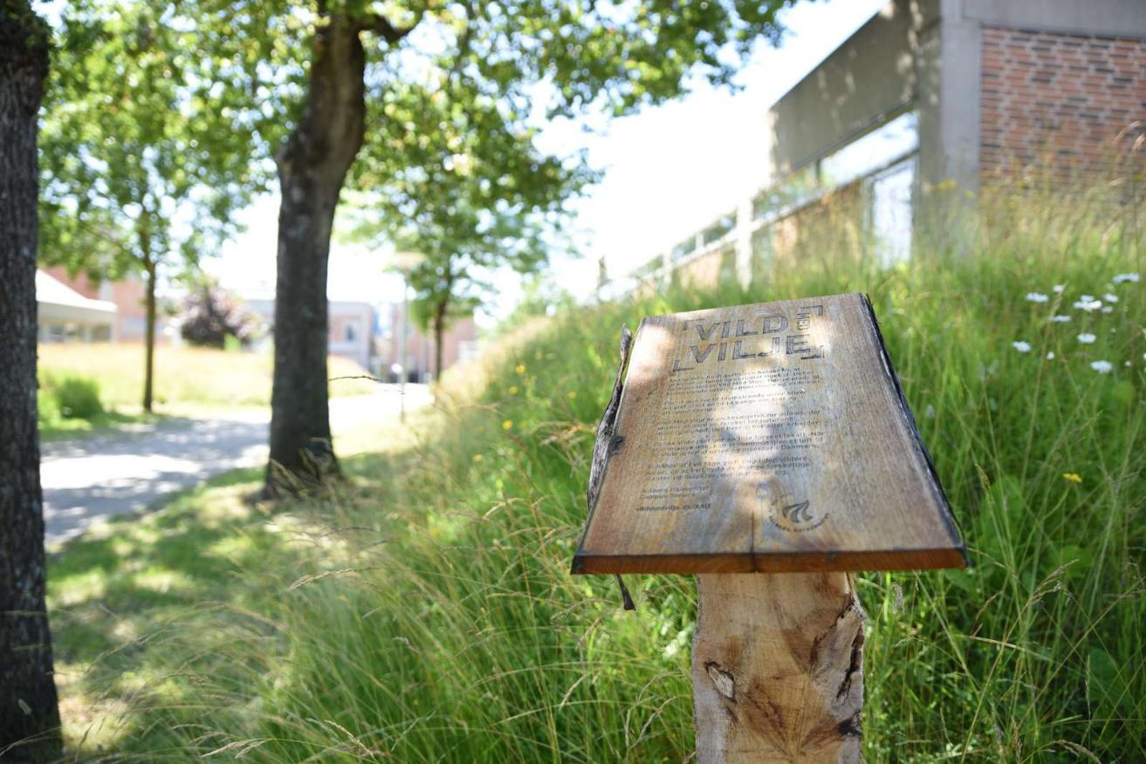
AALBORG UNIVERSITY'S VISION
TOWARDS 2021
AAU maintains and is recognized for our unique profile and high quality in all our activities
AAU is internationally recognized for outstanding problem- and solution-oriented research.
AAU educates students for the society of the future.
AAU lives out its fundamental principles for problem- and project-based learning and is internationally recognized for documented results of the learning method.
AAU is an attractive partner for private companies, public sector authorities and institutions, and our knowledge collaborations are mutual, focused and carefully selected.
SUSTAINABILITY AT AAU

Slide 42

SUSTAINABLE DEVELOPMENT POLICY
AT AAU
Sustainability
AAU works every day to:
Integrate environmental, financial and social sustainability at all levels of
strategic and operational activities.
Be characterized by openness, co-determination and respect for equality and equal standards of living.
Offer education of the highest quality that enables graduates to contribute to a sustainable society.
Deliver the highest quality research that contributes to sustainable, innovative solutions to societal challenges.
Implement preventive measures aimed at protecting the environment and preventing environmental impacts from AAU's operations.
Work with partners who contribute to sustainable development and promote sustainable development in conjunction with local, national and global actors.

Slide 43

CLIMATE GOALS FOR AAU
Sustainability
AAU has reduced greenhouse gas emissions by 70% by 2030 (compared to 1990).
AAU is climate neutral by 2045.
AAU will contribute to Denmark achieving the 70% target by 2023 and climate neutrality by 2045 in the best and cheapest way, as well as work on making it technologically, organizationally and humanely possible to fine-tune these goals.
Achievement of climate goals (cf. annual report 2023). The accounts show that AAU has reduced total CO₂ emissions per user by 81% since 1990 from 16 tons to 3 tons in 2022.
Notes:
The strategy, Knowledge for the World 2022-26, includes a vision that AAU will contribute to sustainable development. As a knowledge institution, AAU must contribute to solving major challenges in society, including climate. AAU has therefore adopted 3 climate goals to support AAU's contribution to the green transition.
Source: Climate goals for AAU, About AAU

Slide 44




SUSTAINABLE DEVELOPMENT AT THE HIGHEST INTERNATIONAL LEVEL
Sustainability
AMONG THE BEST IN SUSTAINABLE DEVELOPMENT
AT THE TOP IN EDUCATION, LESS INEQUALITY, AND PARTNERSHIPS
AAU is No. 4 in the world in terms of the total contribution to the UN Sustainable Development Goals.
AAU is No. 1 in the world on SDG 4 - quality education, No. 3 on SDG 14 - life below water, and No. 4 on SDG 10 - reduced inequality.
Notes:
The UN Sustainable Development Goals will help achieve more sustainable development in the world as we move towards 2030.
The SDGs consist of 17 specific goals and 169 targets that the UN’s 193 Member States must meet.
The Times Higher Education Impact Rankings measure the universities’ annual contribution to the achievement of the UN 17 Sustainable Development Goals on both the individual goals and as a whole. Many different parameters are measured, such as research and teaching in sustainable technologies, policies on equality, and energy efficiency in building operations.
Among the best in sustainable development
AAU is No. 4 (2024) in the rankings that assess the universities' overall contribution to sustainable development, based on the UN 17 Sustainable Development Goals.
1,591 universities are included in the rankings for the total contribution in 2024.
At the top in education, reduced inequality and partnerships
AAU is No. 1 (2024) in the world on SDG 4 - quality education, No. 3 on SDG 14 - life below water, and No. 4 on SDG 10 - reduced inequality. We are particularly proud of the first place for our work on SDG 4. At Aalborg University, it is our vision, as a mission-oriented university, to contribute to sustainable development in collaboration with the wider world. We cannot overcome the world's crises as individual actors.
Source: Times Higher Education Impact Rankings 2024

Slide 45

ENGINEERING CONTRIBUTES TO SUSTAINABILITY WITH 9 FOCUS AREAS
Sustainability
Energy production and distribution
Flexible and efficient energy consumption
Transport and mobility of the future
Sustainable cities, buildings and components
Environmental technology, nature and biodiversity
Agriculture and food technology
Sustainable production
Recycling and circular economy
Medical, health and welfare technology
Notes:
Initiatives that define the faculty. Not exclusive, but the areas that have our focus.
Defined in collaboration with the departments.
The nine focus areas in sustainability are strategic lenses that we believe will pave the way for future missions.

Slide 46


SUSTAINABILITY AREAS
Sustainability
Renewable energy: wind, solar, waves, tidal water, geothermal and hybrid facilities
Robust and reliable power distribution: conversion, storage, and sector coupling for the heat, gas, and fuel sectors
New efficient storage technologies
Managing systems using advanced controls like AI, IoT, Big Data, etc.

Slide 47

SUSTAINABILITY AREAS
Sustainability
Energy savings as well as efficient systems and components in the consumer sector which includes industry, buildings and various appliances
Flexible systems where consumption is adapted to production
Production of renewable energy in buildings and integration of buildings into the energy system
Use of technology, behaviour and everyday practices
Control and application of digital solutions such as AI, IoT,
Big Data

Slide 48

Sustainability
SUSTAINABILITY AREAS
Heavy transport: Power-to-X, biofuels, capture and storage of CO₂ (carbon capture)
Light transport electric vehicles, hybrid vehicles, fuel cells, range extenders, infrastructure for charging, etc.
Drones and robots for transporting goods, monitoring and diagnostics in the environmental and energy areas
Energy savings through lightweight constructions and new materials, as well as improved logistics and supply chains
AI for intelligent traffic management, green driving behaviour, autonomy, and driver support
Use of technology, behaviour and everyday practice

Slide 49

Sustainability
SUSTAINABILITY AREAS
Sustainable materials, components and processes in construction as well as improved indoor climate
Urban supply infrastructure including sewers, rainwater, etc.
Social and economic sustainability, Life Cycle Cost (LCC), Life Cycle Analysis (LCA) for materials and CO₂ loading
Digitalization and utilization of data in order to optimize construction processes in the design, execution and operation phases
Use of technology, behaviour and everyday practices.
Construction and urban planning that takes into account nature and green recreational areas in cities

Slide 50

Sustainability
SUSTAINABILITY AREAS
Alternatives to pesticides
Preserve biodiversity in terrestrial systems, marine and fresh waters
Sustainable fisheries
Monitoring of environmental status and biodiversity through the utilization of tools and smart solutions (including drones and eDNA)
Utilization of microbes to ensure a good environment and clean drinking water, sustainable development and reuse of resources, as well as animal and human health

Slide 51

Sustainability
SUSTAINABILITY AREAS
Genome-based breeding using molecular techniques, modelling and predictive algorithms
Sustainable alternatives to pesticides – including the use of endosymbionts to control pests
New DNA-based methods for identifying and tracing disease-causing organisms
Technology for agriculture, stables and food production with a focus on sustainability, animal welfare, autonomy, efficiency, etc.
Green biorefining for sustainable production of feed and food protein, energy and fertilizer.
Alternative protein sources such as plant and insect-based foods, feed and sea-based aquaculture

Slide 52

SUSTAINABILITY AREAS
Sustainability
Smart production using drones, robots, exoskeletons, etc.
Sustainable processes, materials and construction to reduce the environmental footprint of production and the supply chain
Reduction of resource consumption through development and exploitation of the potentials of smart manufacturing, e.g. IoT, Big Data, AI, and robots
Reconfigurable production systems with modular units and the use of AI and Big Data developed in the context of human practices to ensure the sustainable transition

Slide 53

Sustainability
SUSTAINABILITY AREAS
Recycling of plastics, building materials and components
Sustainable use of residues and waste products
New sustainable methods for circular production such as ‘take-back’ and ‘life cycle data’
Development of processes and systems for the recovery of biosurfactants to replace synthetic surfactants in feed, food, personal care and detergents
Development of methods for better utilization of waste and residue production
Sustainable materials designed for recycling
Recycling and requalifying of potential of end-of-life products

Slide 54

Sustainability
SUSTAINABILITY AREAS
Utilizing the growing information universe of the future (Big Data) for the development of new diagnostic treatments
New methods as well as animal and plant models for determining genotype – phenotype, correlation, etc.
AI-based link between genetics, protein structure and function
Development of innovative medical, health and welfare technology (e.g. exoskeletons, self-charging pacemakers, new drug delivery systems, micro-robots, biomechanics, etc.)
Notes:
It is unclear which departments work with which research areas

Slide 55

AAU STRATEGY
KNOWLEDGE FOR THE WORLD
2026 - 29

Slide 56




OUR FOUR
STRATEGIC
THEMES
We strengthen our leading
position in engineering
We expand and develop our mission initiatives
We drive innovation and growth
We attract and develop talented researchers

Slide 57

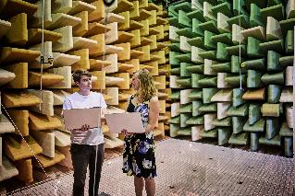
Teach the technologies of tomorrow and integrate the latest teaching methods
2029
Sharp profile of the degree programme
portfolio
Where the brightest engineers of the
future are hatched
Invest in positions of strength and research infrastructure
Promote collaboration between the engineering field and AAU's other research areas
Support innovative and cross-faculty projects

Slide 58

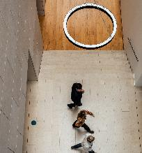
2029
Clear and structured method
Where the
foundation stones
for the great
breakthroughs are laid
Develop project portfolio
New mission award
Disseminate awareness of the missions
Organisational and managerial rooting

Slide 59

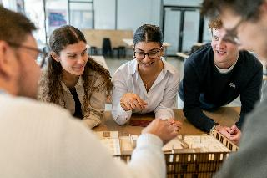
Link AAU’s strong research environments and activities with national and regional needs
2029
Innovation must have a clear place
in the research environments
Where innovation
matures and
becomes reality
Identify and mature next generation of innovation areas
Secure the funding chain for innovation
Exploit new, expanded framework conditions
Simplify processes and make frameworks clearer
New innovation academy

Slide 60

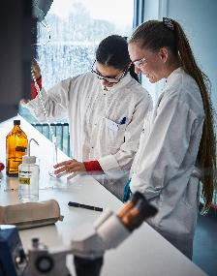
Increase awareness of our strong research environments
2029
Present AAU's attractive opportunities to new research talents
Where talents truly
thrive and develop
Leadership focus and strong talent culture
Find, support and develop particularly talented researchers
Strengthen mobility
Retain and include the international research talents

Slide 61

Faculty of Medicine
AALBORG university

