Slide 1

Jan Pajntar, 2015/2016,
Erasmus Master exchange

Slide 2

Aalborg is the 4th biggest city in Denmark with approximately 205.000 inhabitants
It‘s a nice multicultural university city
It‘s a good starting point for tours of the neighbouring cities such as Aarhus (2nd biggest city in Denmark), Copenhagen, Oslo (Norway)
It has a beautiful ZOO and a small airport (although it doesn‘t have good connections to the world☺)

Slide 3
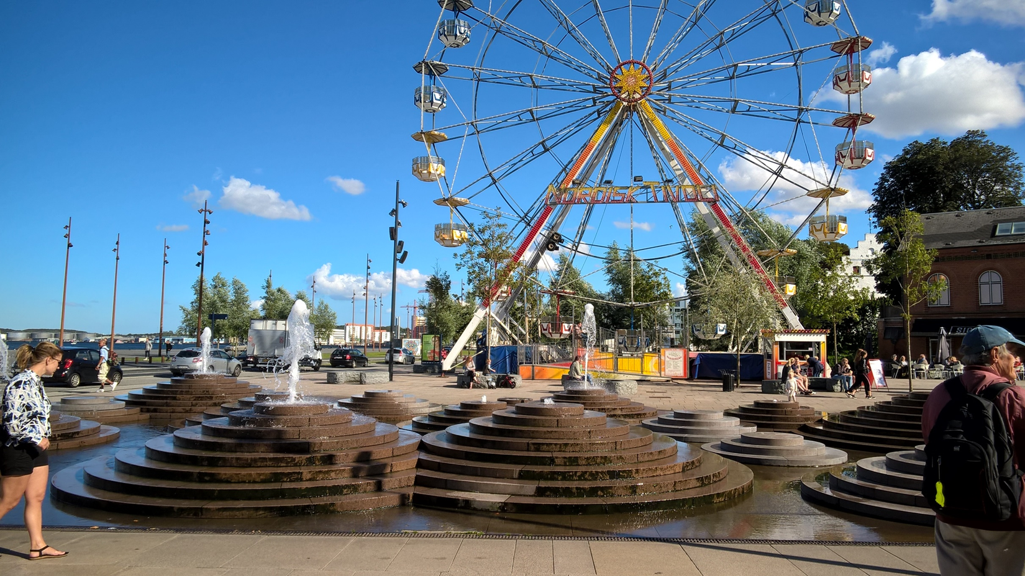
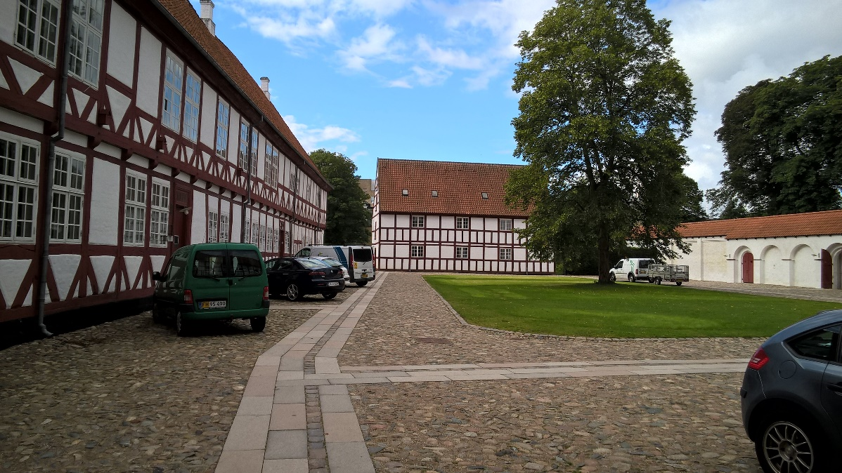
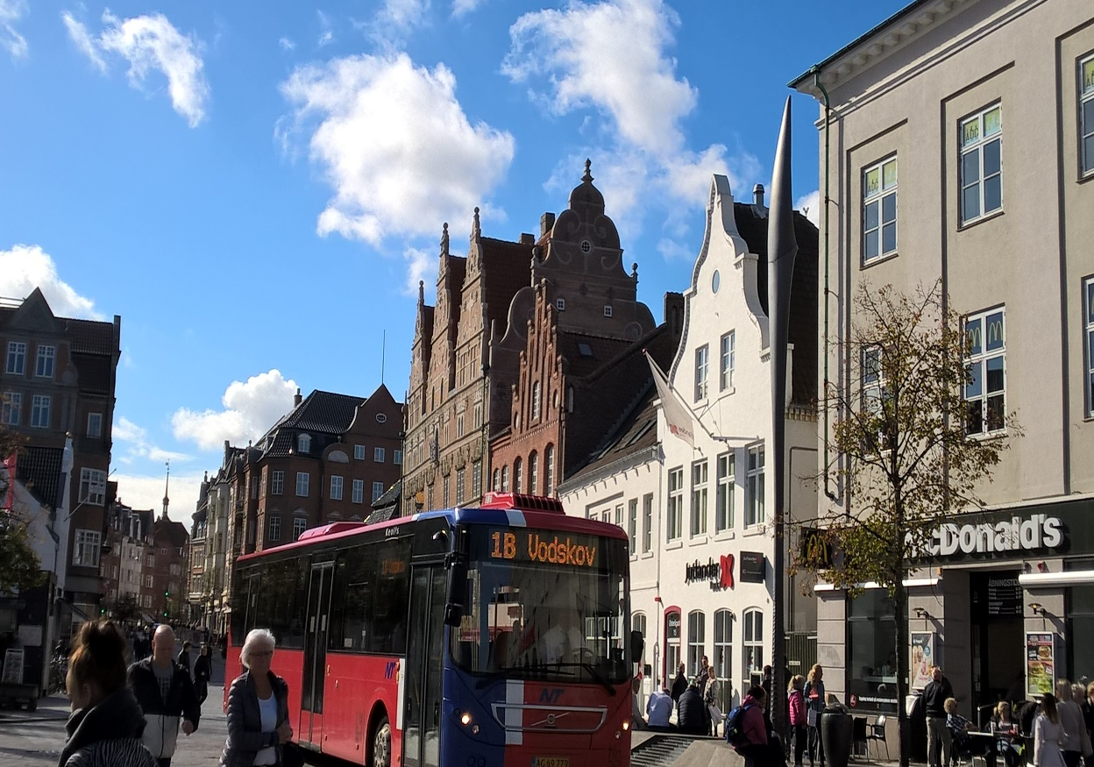
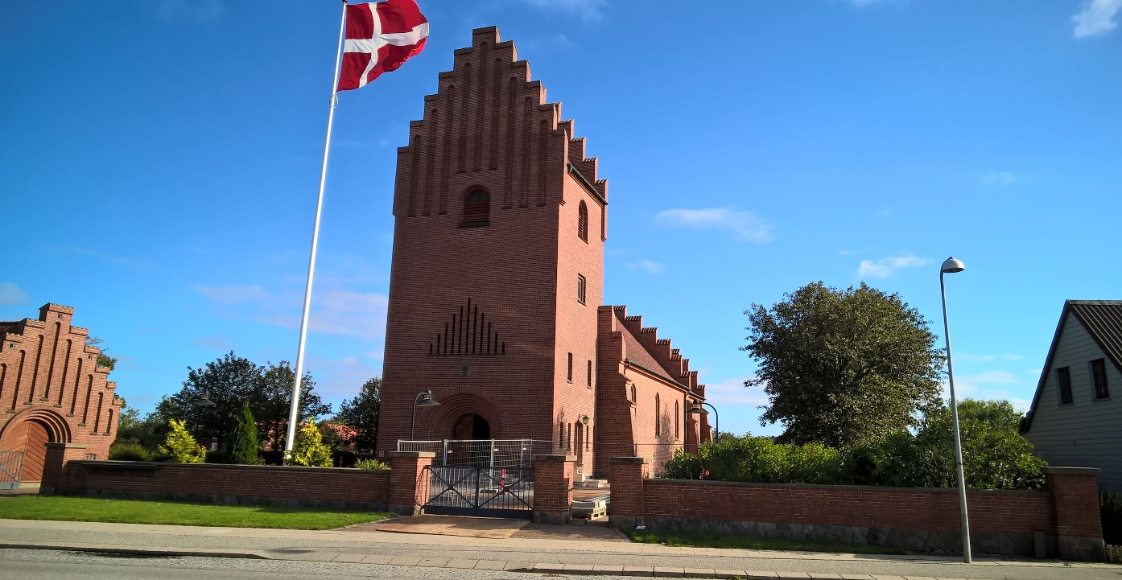

Slide 4
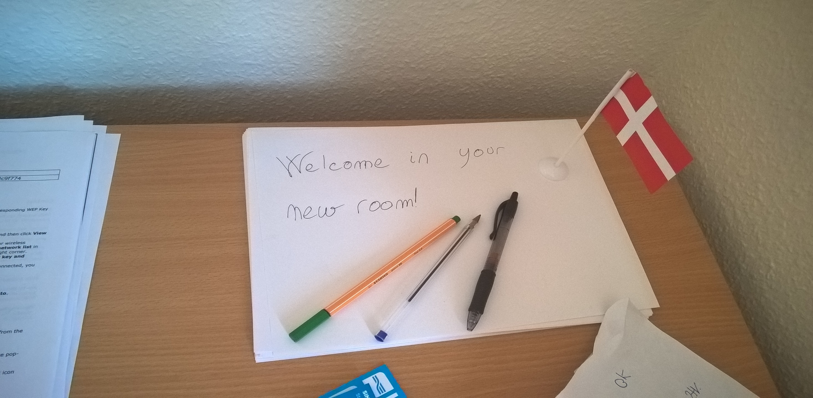
Accomodation:
Most students live in the campus which is located approx. 6 km from the city center
There are also some student residences which are in the city center where most of the international students reside (I highly recommend accommodation in the city center. The street Boulevarden is a very lively place to be☺)
It‘s also possible to stay in private accommodations, but it‘s usually more expensive than the other student residences
Monthly rent for student room is approx. 3100 DKK
Payable in two installments together with a deposit (2 months rent), that is returned to students when they leave the student accomodation

Slide 5
Costs of living:
Costs of studying in Denmark is higher than in other countries, especially for eastern european countries
The price for food and beverages in stores is the same, but in restaurants it‘s significantly more expensive
The option for a cheap meal is available at the student cafeteria on campus
The beer in the bar / club cost up to 52 DKK
Coffee is approx. 33 DKK
Monthly ticket for the city bus costs 373 DKK
Average living costs range between 3000 and 4000 DKK(in addition to the rent)

Slide 6
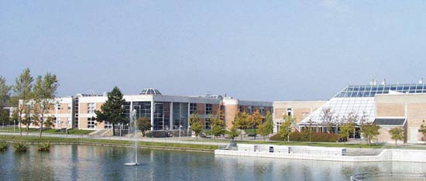
Aalborg university
University has around 20.000 students, 4000 of them are international students
It‘s very strong in technical science; most foreign students come for a full master's degree. There is a relatively small number of Erasmus students (at least that was my feeling☺)
The University strongly promotes teamwork and PBL (Problem Based Learning) but in the case of legal studies that is not the case
International students come from all over the world
It‘s located approx. 6 km south of the city center, although few faculties are located in the city center (eg. Architecture)

Slide 7
Law faculty
You can choose courses from this website: http://www.law.aau.dk/student-exchange-programme/course-programme/
You can enroll in their Vis Moot team (in case of a full year exchange)
Lectures are in English, some courses are taught by an American professor named Kristen Christiansen who lives in Aalborg.
Each course has 10 ECTS and it ends with an oral exam. The oral exam lasts approx. 15 min
Lectures begin in September and are finished by mid-November. Exams are in November and January. When there are a small number of erasmus students in a program, you can arrange to finish all the exams by the end of December.

Slide 8
International office
International office has a very kind and helpful coordinator (marla@law.aau.dk)
International students are assigned to two tutors, one is for general stuff while the second is only for law studies
Upon arrival there are many governmental tasks you will need to complete; Such as: resident registration, check-in student assessment system, health insurance, various registrations for student bus tickets etc.,
Tutors can be very handy for the registration proccesses

Slide 9
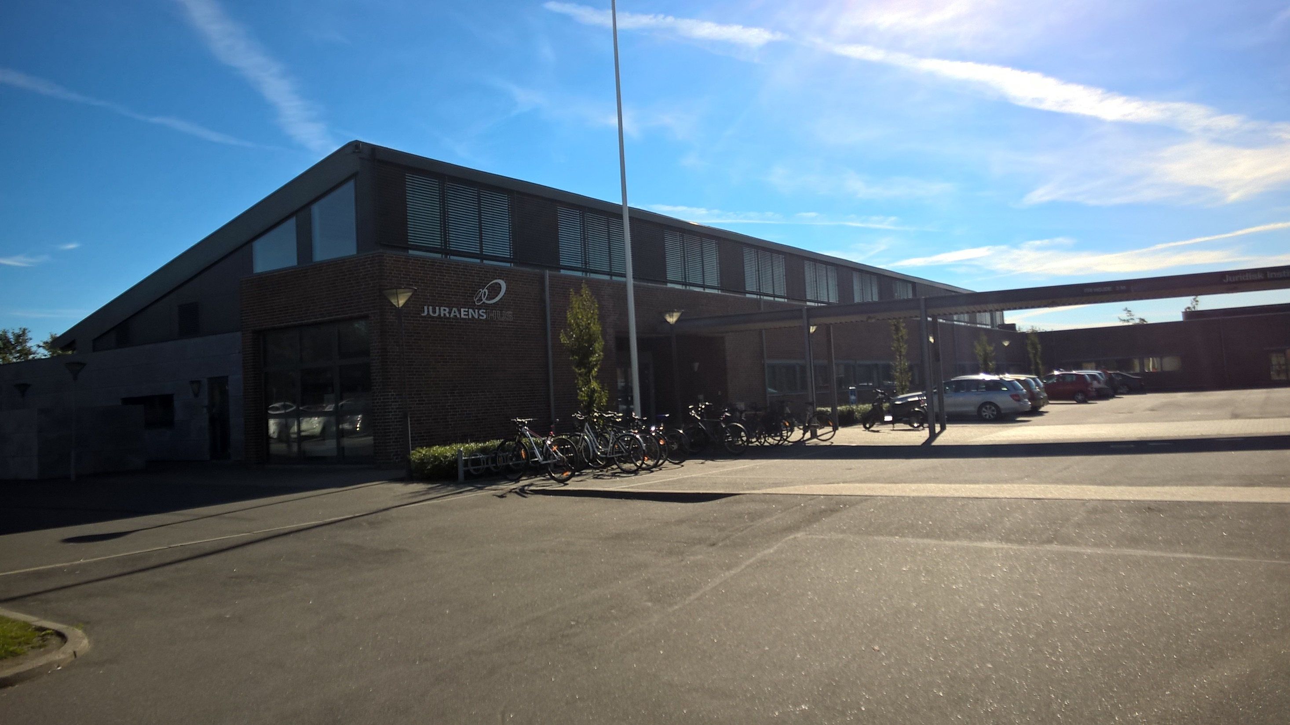
Law Faculty

Slide 10
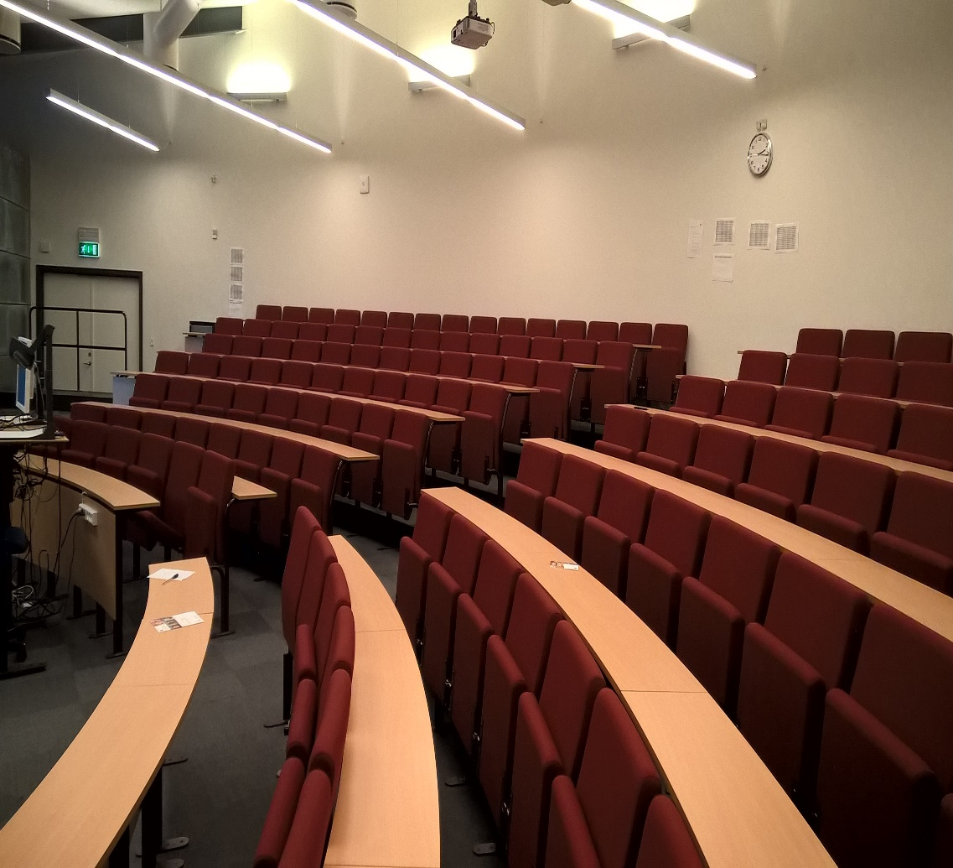
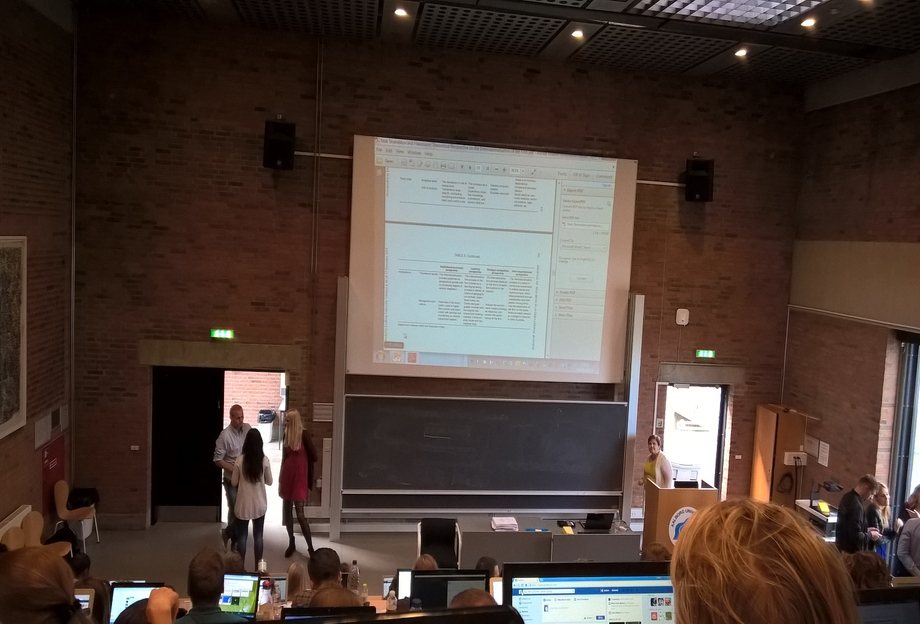
In the picture to the left is the largest classroom at the Law Faculty, on the right is a classroom at the Economic Faculty

Slide 11
Extracurricular activities:
-At the beginning of the school year all the sports / cultural clubs are presented at various fairs where you can enroll for free
- A large variety of student organizations prepare various events, trips, entertainment, etc.
It‘s possible to learn Danish for free. The lessons are three times a week in the municipal language center called Sprogcenter
University offers free courses in other languages (Spanish, French, etc.).
despite the fact that Denmark is an expensive country to study, lots of things are available for free☺

Slide 12
Night life in Aalborg
The city has a special party street called Jomfru Ane Gade with more than 20 clubs and pubs
Every Wednesday there are international nights in a student house in the center of the town which is very popular among students
In addition there are two popular clubs called 1000 FYRD and Platform 4 which have more alternative music and arts program

Slide 13
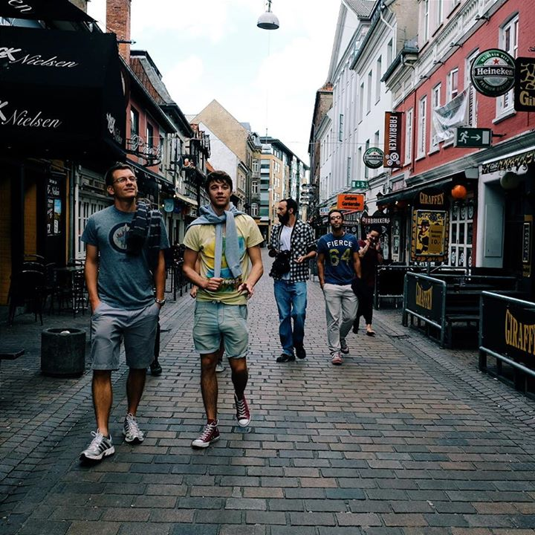
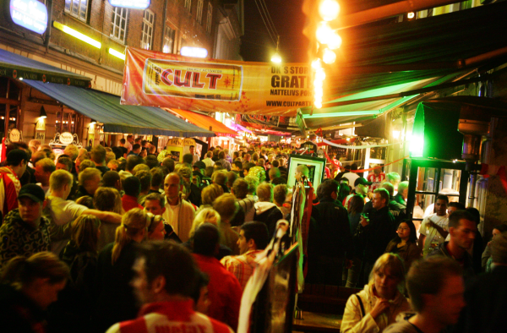
Left Jomfru Ane Gade by day, on the right the same street at night

Slide 14
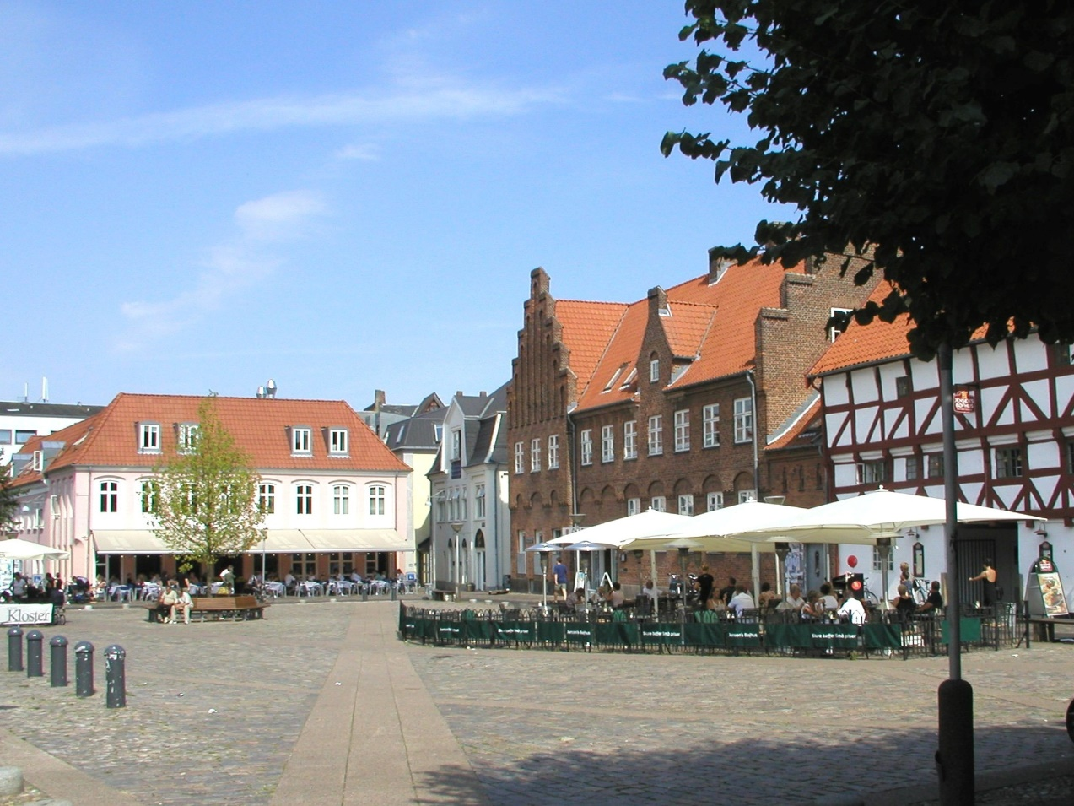
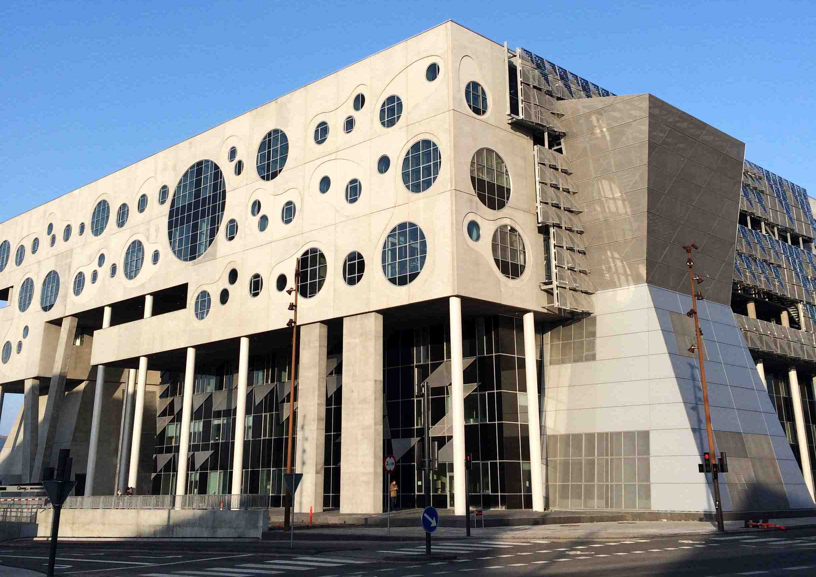
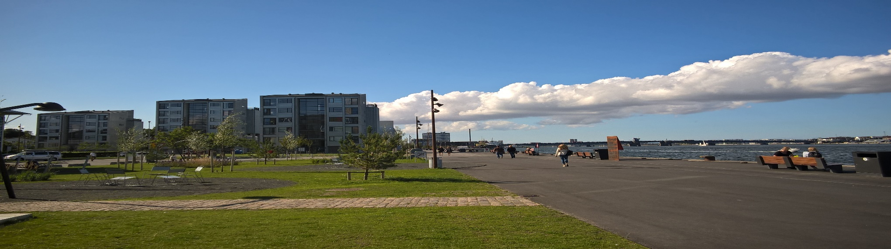

Slide 15
Usefull websites:
http://www.en.aau.dk/ webpage of the Aalborg University
http://www.en.aub.aau.dk/ University library
https://lifeinaalborg.wordpress.com/ webpage with usefull advices on how to save some money in Aalborg
http://sprogcenteraalborg.dk/ danish language center
http://www.rejseplanen.dk/ bus and train schedules
https://gomore.dk/ ride-sharing website

Slide 16
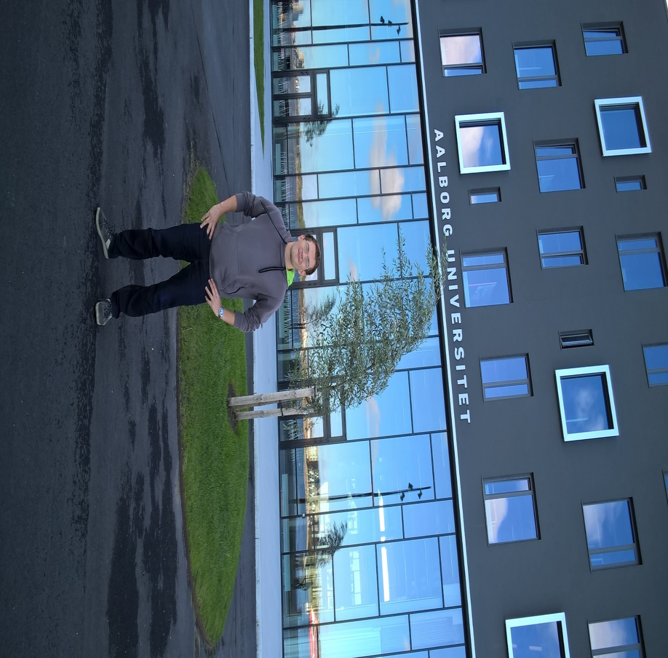
For any questions/advice please contact me via FB or on my email: jan.pajntar@gmail.com

