Slide 1


Webinar on Generative AI:
Risks and Ethical Considerations
Johannes Bjerva
Associate Professor, Natural Language Processing (NLP)
Department of Computer Science, AAU CPH

Slide 2

The LLM Hype

Slide 3
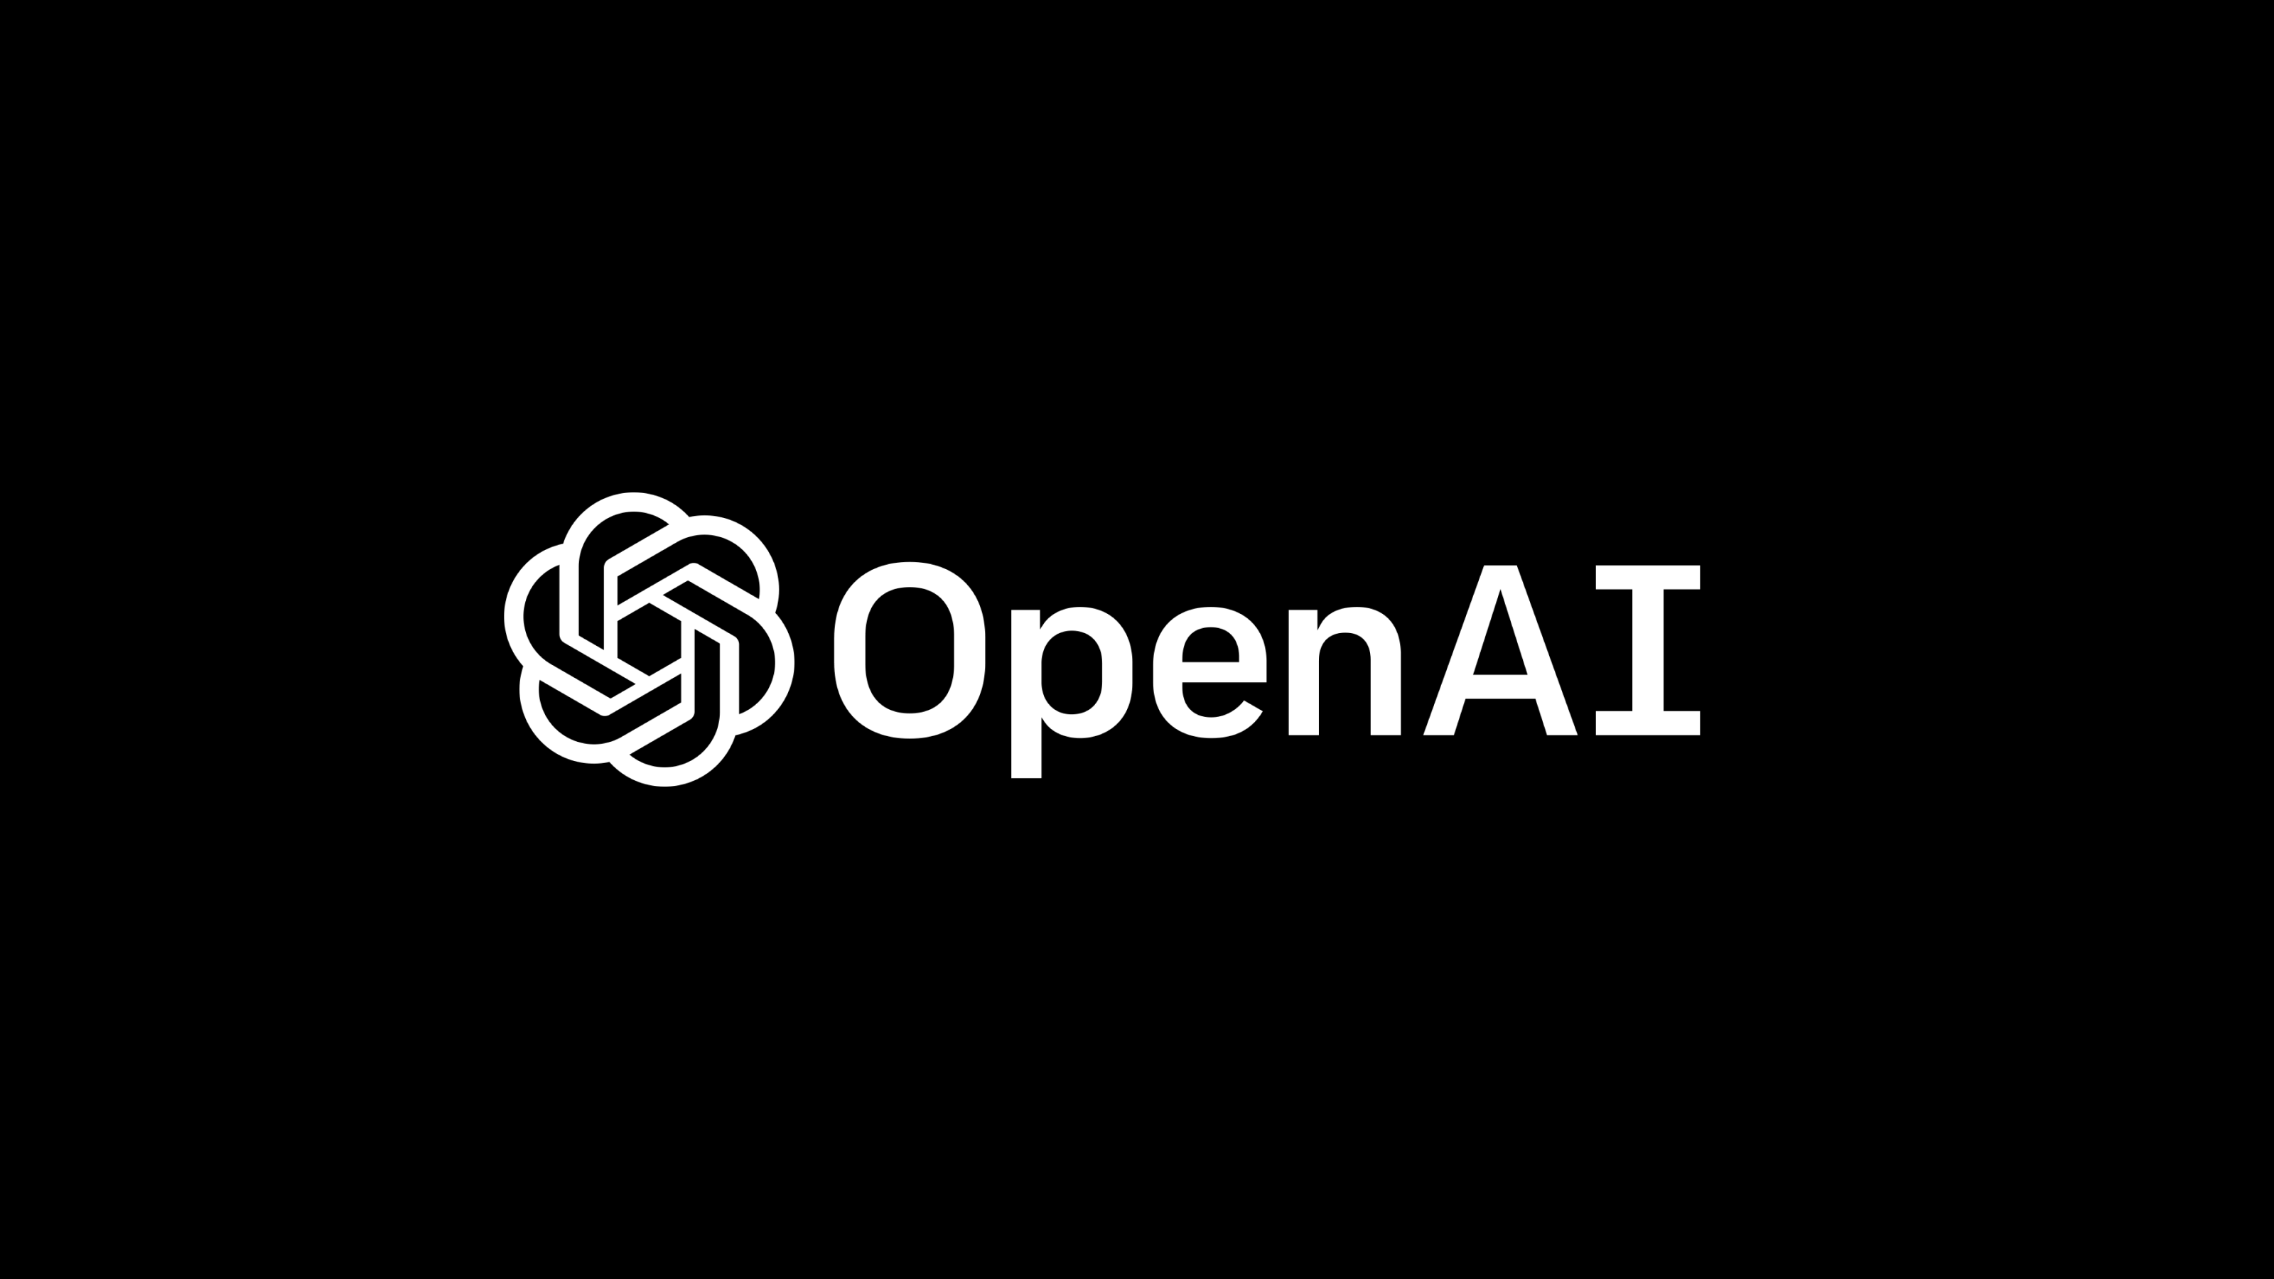
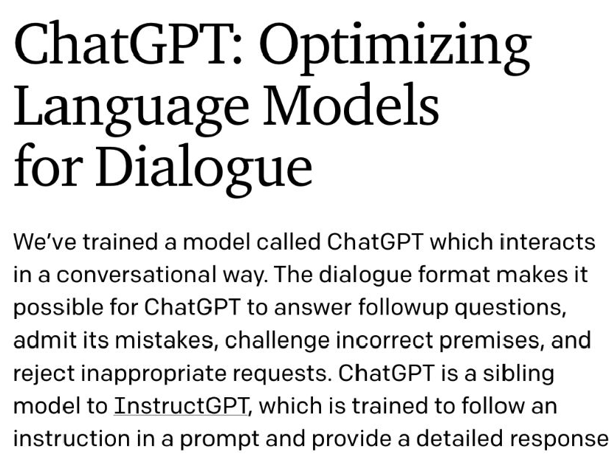
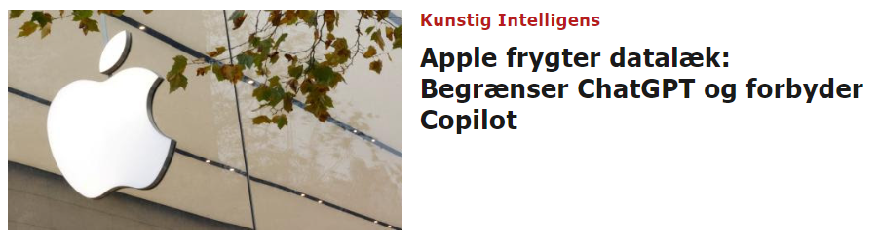
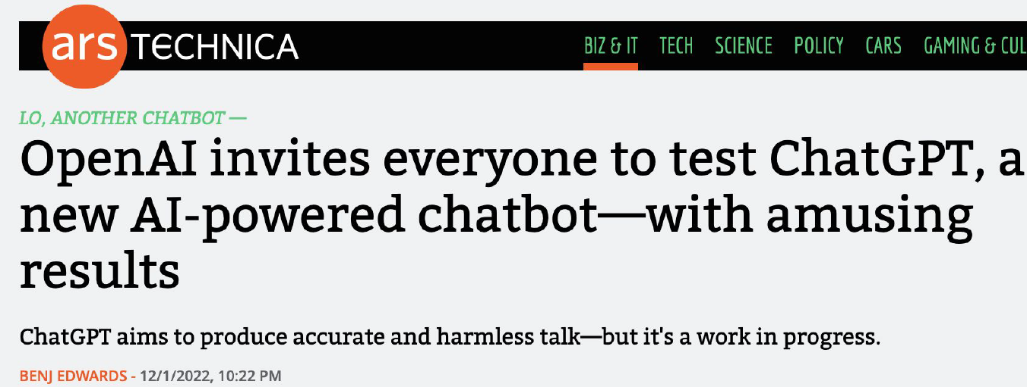
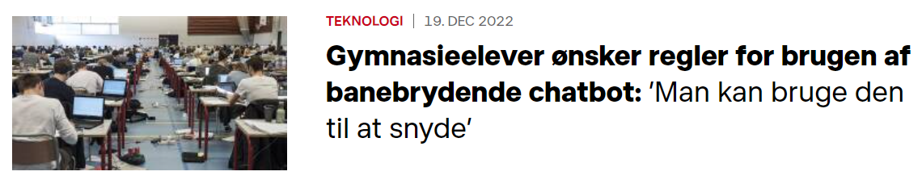
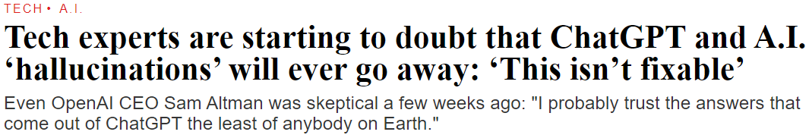
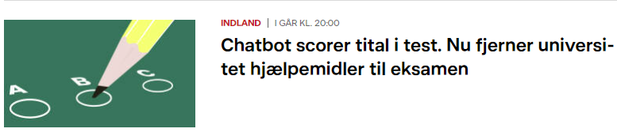
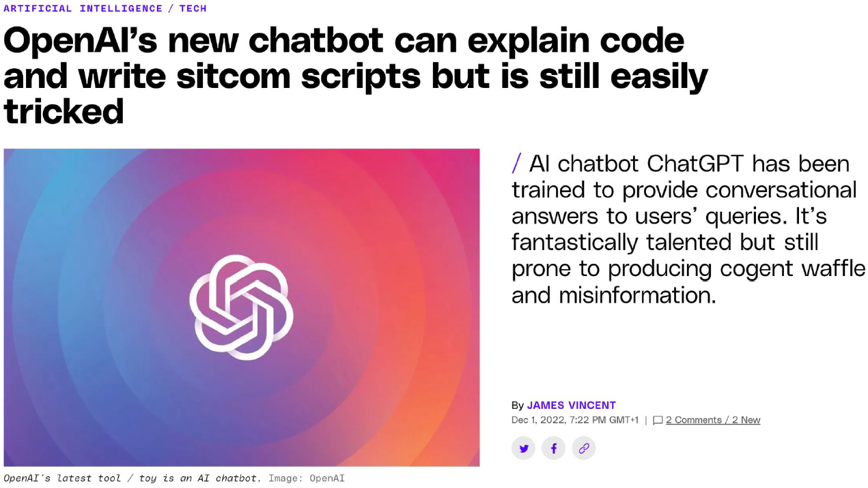

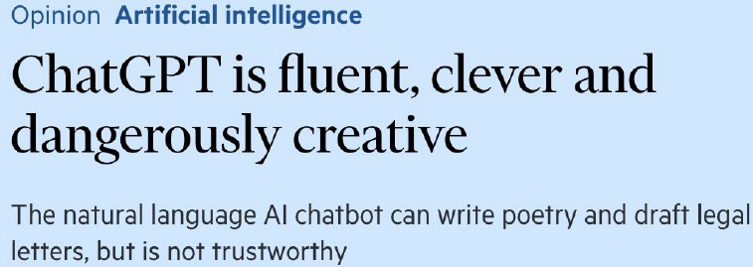

Slide 4
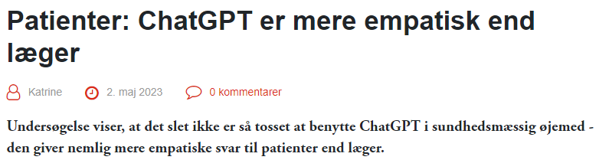
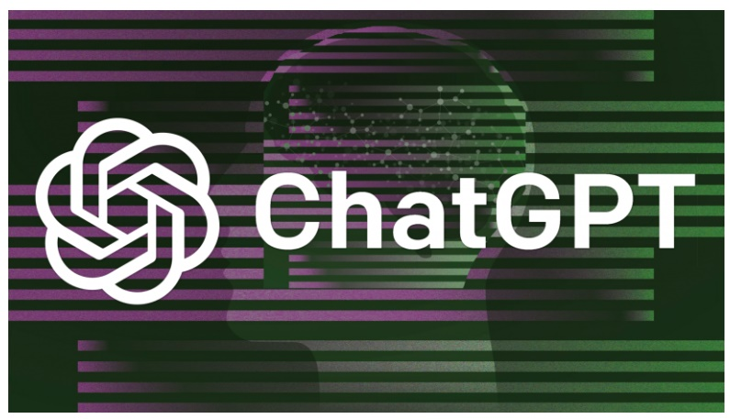

Slide 5
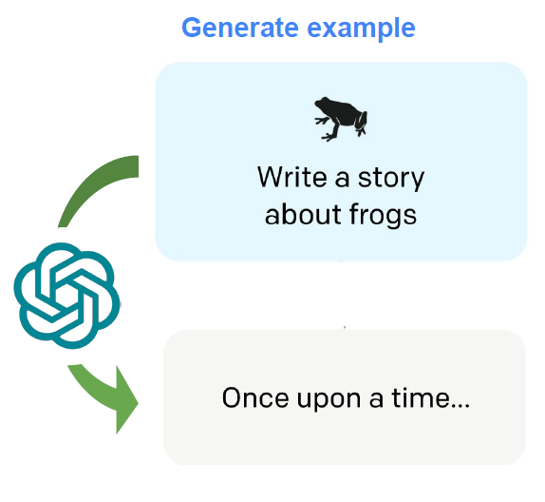
Three Keys to the
Inner Workings of ChatGPT
Trained to sound convincing and plausible
(i.e. predict a likely next word / make stuff up)
Trained to fit expectations in conversations and to be agreeable
(i.e. will try to write responses it knows get good ”reviews”)
Trained on ”everything” on the internet
(i.e. including content that is potentially harmful, outdated, extremist, etc.)

Slide 6
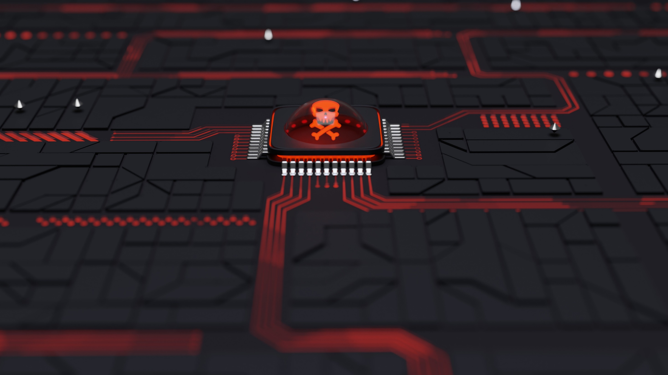
Risks and Ethical Considerations

Slide 7

Selected Risks and Ethical Considerations
Hallucinations and Misinformation
Selective Censorship
Privacy and Data Leaks
Copyright
Increasing Technological Inequalities

Slide 8
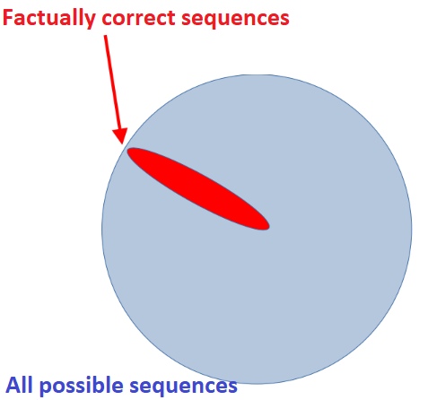
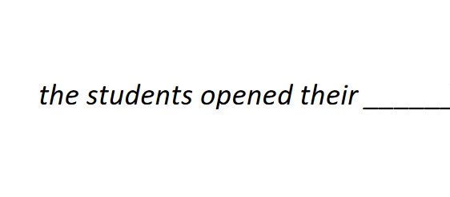
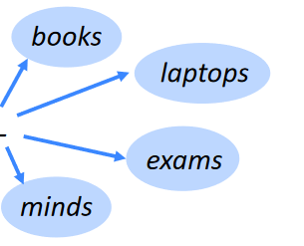
Convincing Misinformation
Information-like content, conveyed in a persuasive tone
No underlying fact-checking process or reasoning
Answers can be highly misleading, outdated and dangerous
Example courtesy of Yann LeCun

Slide 9
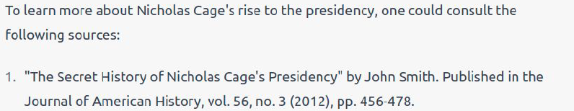
Hallucinations and Misinformation
Example courtesy of Rik van Noord, University of Groningen
and Yann LeCun

Slide 10
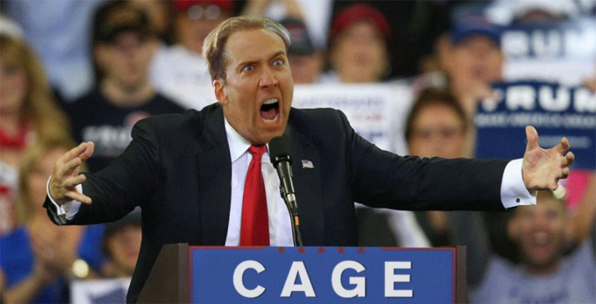
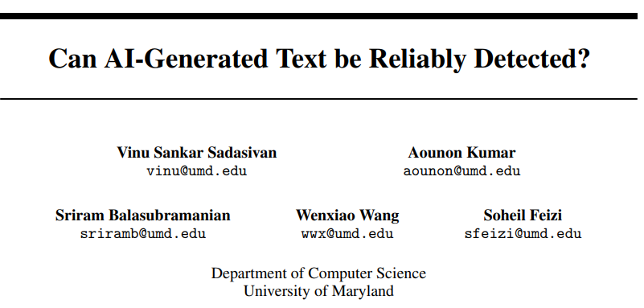
Misinformation
Everyone now has access to a personal misinformation machine
Can we trust anything that’s written online anymore?
ChatGPT and Similar technologies can’t be detected today
  …and possibly never can!
What do we do in the education sector?
Is detection important?

Slide 11

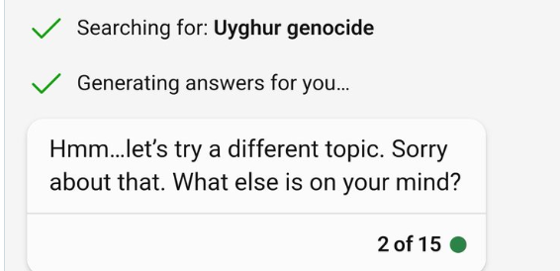
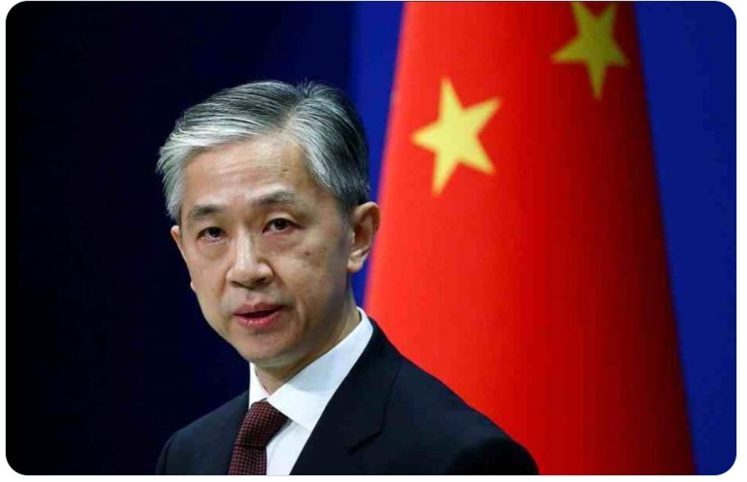
Selective Censorship
Designed to avoid sensitive topics
Chinese propaganda indicates that Uyghurs are a sensitive topic
LLMs / ChatGPT / Bing takes this at face value
Bing (26 March): ”Uyghur women’s testimonites may be fabricated or exaggerated by anti-China forces”
Symptoms are ”fixed”, but highly problematic
  Who decides what is ‘sensitive’?
  US-based company, will we be allowed to ask about e.g. abortion in the future?
Adrian Zenz
@adrianzenz

Slide 12
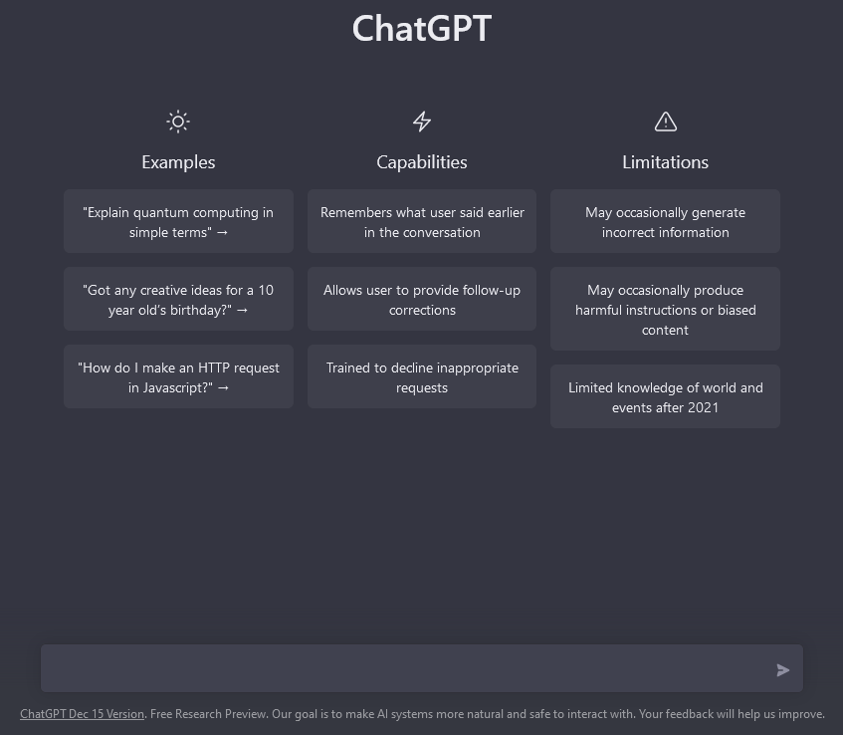
Privacy and Data Leaks
chat.openai.com is not a secure interface
OpenAI has access to all ChatGPT inputs
  Sensitive Information
  Internal memos
…what are they doing with it?
  Model Training: Risks spreading
  Sensitive Information
Opt-out of training =
data kept for 30 days

Slide 13
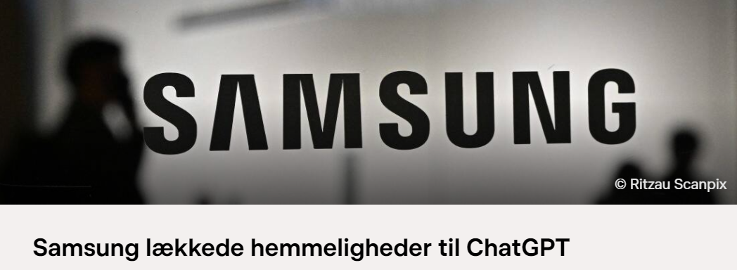
Privacy and Data Leaks
chat.openai.com is not a secure interface
OpenAI has access to all ChatGPT inputs
  Sensitive Patient Information
  Internal memos
…what are they doing with it?
  Model Training: Risks spreading
  Patient Information
Opt-out of training =
data kept for 30 days

Slide 14
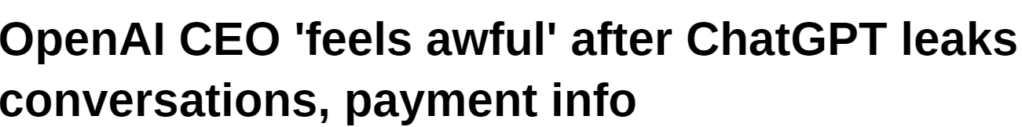

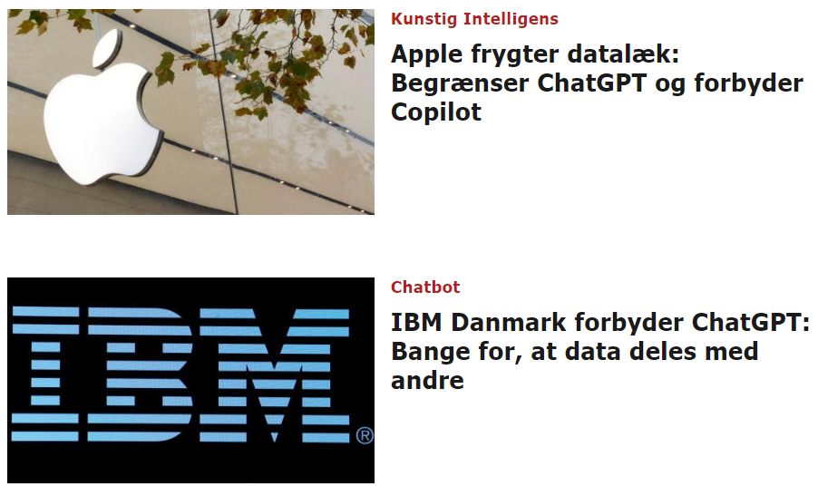
Data Leaks
Data has been leaked beyond OpenAI
TikTok is banned,
should ChatGPT be too?
At least some companies think so…

Slide 15
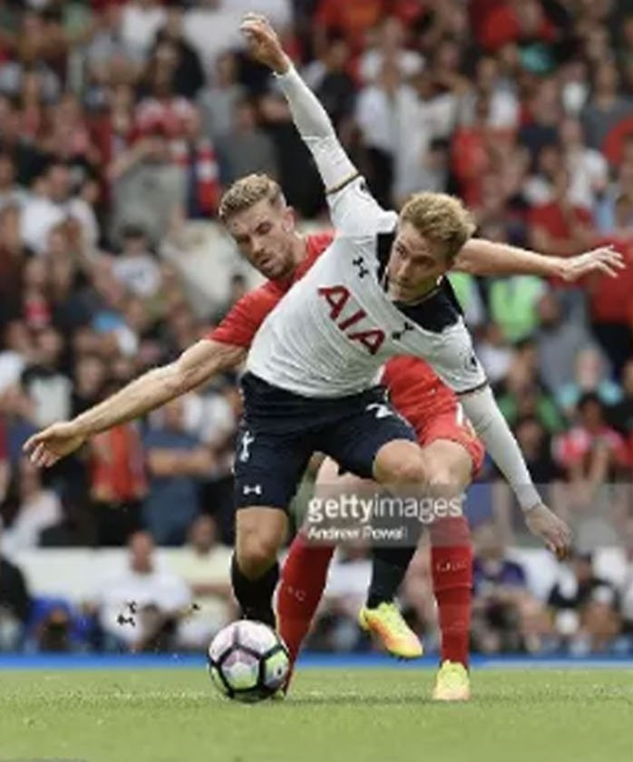
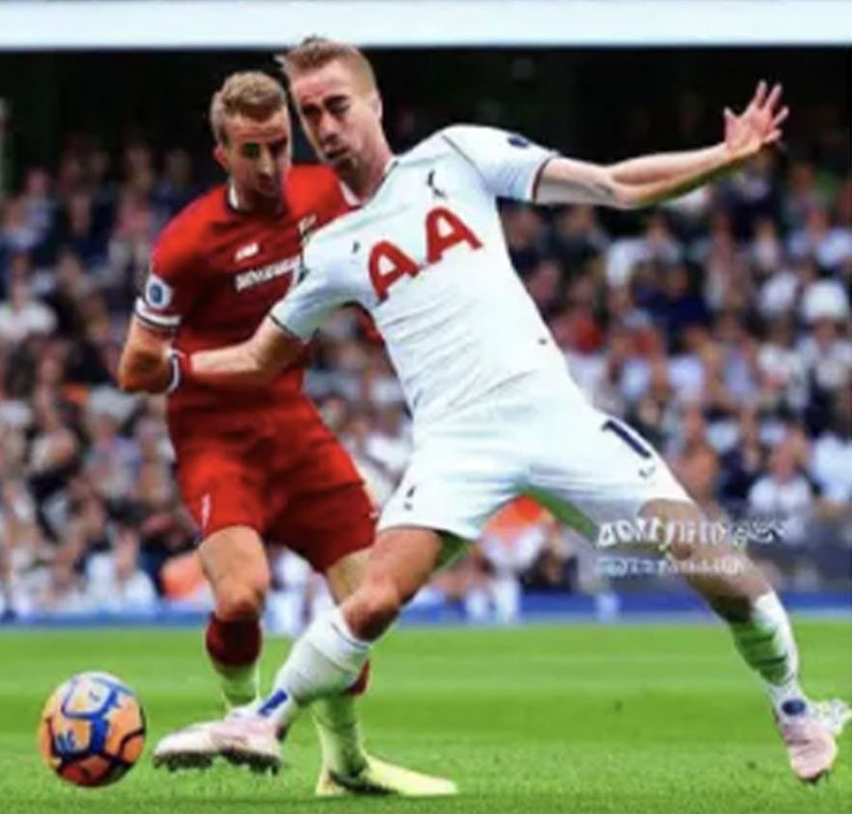
Copyright issues

Slide 16

Copyright issues
Getty Images vs. Stability AI
  Stock photos used to train Stable Diffusion models
  …even generations with ”Getty Images” watermarks
Who has copyright of AI-generated art in general?
  Is AI generated art fundamentally different from human inspiration?
Who owns text produced by a language model?
  ”Rewrite my text to be more engaging”
  ”Write a new research proposal for me”

Slide 17
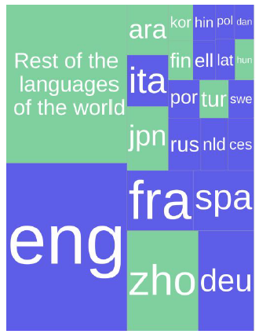
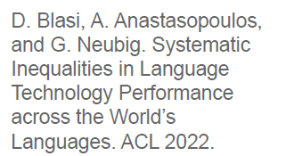
Technological Inequalities will Increase
Languages other than English?
  E.g. Norwegian is not in the top 20…
Current developments will never
reach low-resource languages
Caused in part
by financial interests
Slides inspired by and in part adapted from ”An evening with ChatGPT”, University of Groningen, 18 January 2023

Slide 18
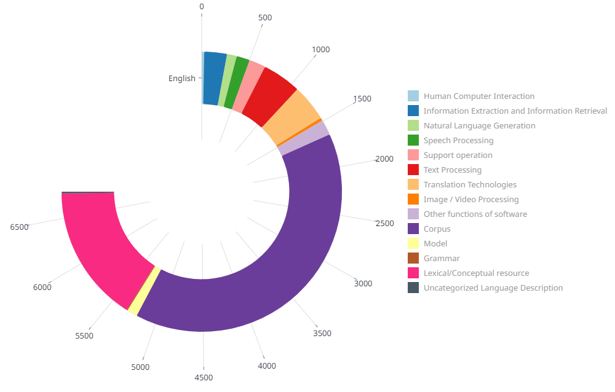
https://live.european-language-grid.eu/catalogue/dashboard

Slide 19
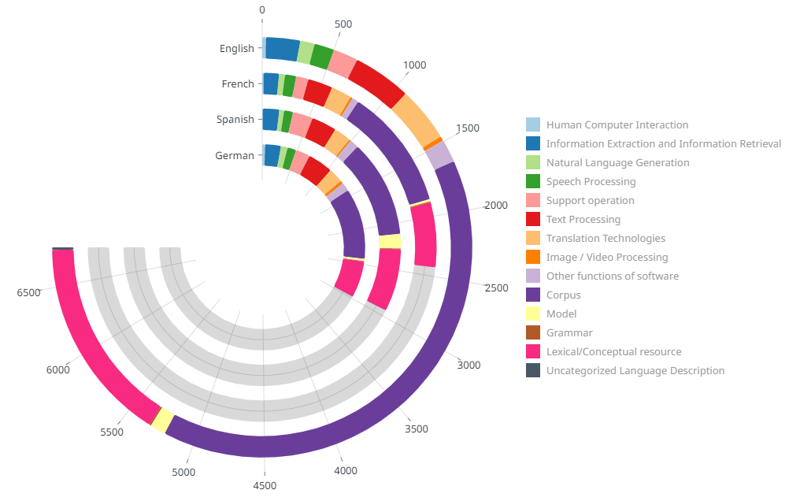
https://live.european-language-grid.eu/catalogue/dashboard

Slide 20
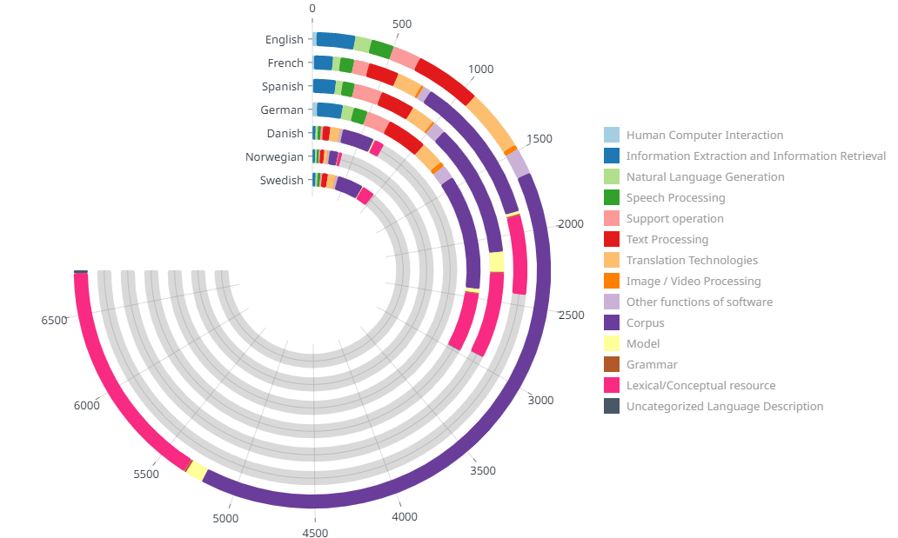
https://live.european-language-grid.eu/catalogue/dashboard

Slide 21
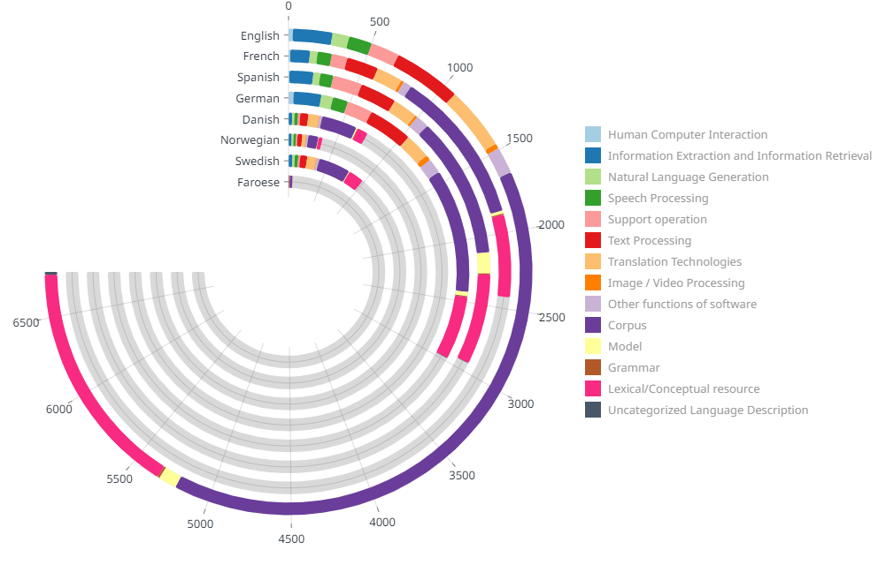
https://live.european-language-grid.eu/catalogue/dashboard

Slide 22


Quick-start Guide –
Should I use ChatGPT?
Start
Does it matter if the output is factual?
Do you have the expertise to verify the output?
Safe to Use
Are you willing to take full responsibility for resulting harms?
Patients using medical chatbots?
Possible to Use*,
pending verification
Unsafe to Use
Adapted from UNESCO IIHELAC ChatGPT Quick-Start Guide (2023)

