Slide 1
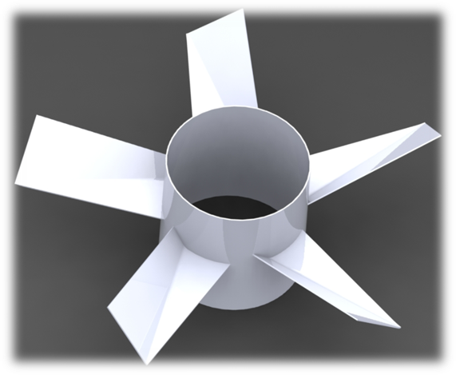
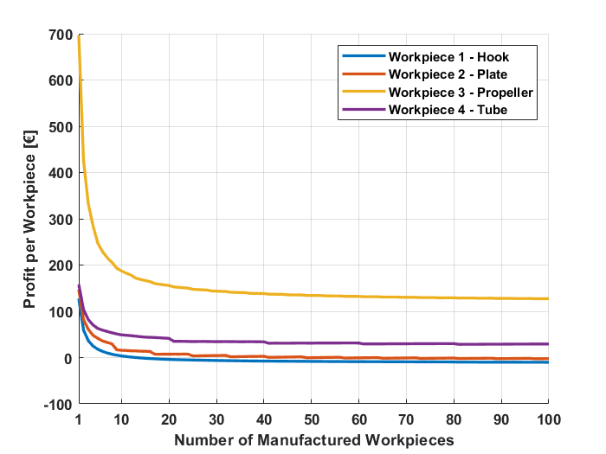
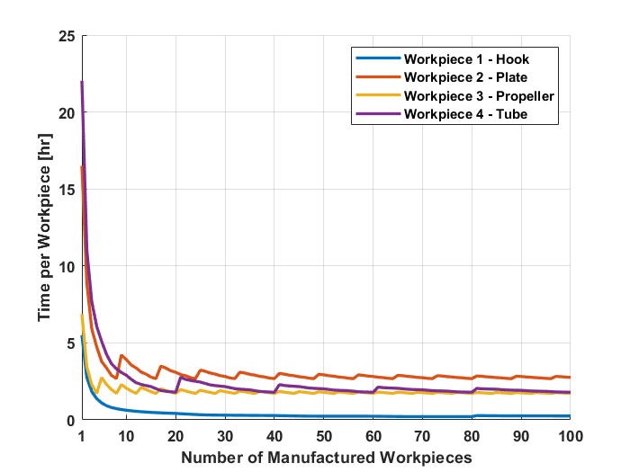
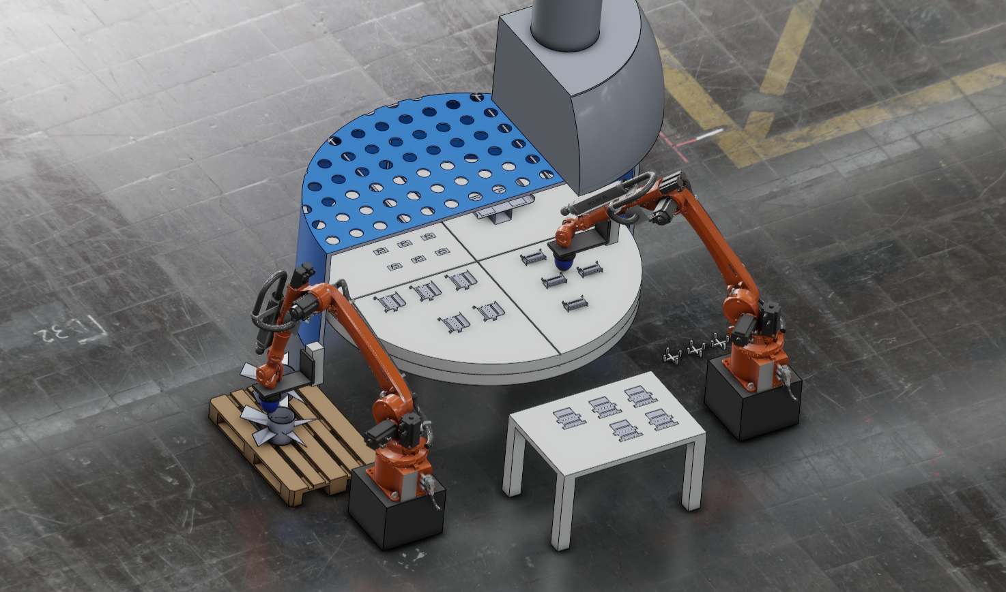
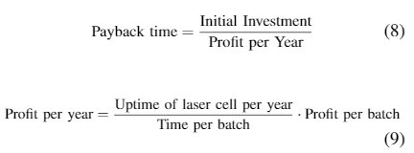
8
Manufacturing Concepts for Laser Processing
Anders B. N. Jensen, Bjarke E. Andersen, Emil R. van der Bijl
Department of Materials and Production, Aalborg University, DK
1. Abstract
3. Economics of Laser Manufacturing
Through a literature study on laser manufacturing an analysis is conducted to explore the four processes: Laser bending, cutting, drilling, and welding. Afterwards, an analysis of the production of a partnership company, is conducted. Based on these analyses a problem statement with an associated requirement specifications is formulated.
Additionally, assumptions and delimitations of the project are formulated. Based on the problem statement different conceptual suggestions are generated and evaluated. One of these concepts are chosen for further development. This is done by implementing the concept in a virtual production.
Keywords: Laser processing, Virtual commissioning, Process integration, Discrete event simulation, Operation analysis
It is assumed, that only workpieces with characteristics similar to a benchmark workpiece
are manufactured by the laser cell. This is regarded reasonable, because both workpieces with higher and lower complexity are expected to be manufactured in the laser cell. Using the profit for the propeller to determine a payback time is also regarded reasonable, because the sales prices are expected to follow the degree of complexity.
The calculations are based on two cases: One where the CD workstation needs to be bought, and one where it is already implemented in the production facility. The payback times are calculated to 1 year and 1 month when the CD workstation is already implemented, and 3 years and 9 months if it needs to be bought.
4. Conclusion
2. Modular Function Deployment
Based on the methods for concept generation, a solution which fulfils the required functions is developed. The chosen solution is Solution C and it is further developed in 3DEXPERIENCE, where considerations about the components are conducted when creating the virtual setup. However, the virtual setup was not completed, and a functional virtual setup is therefore not developed yet. If this is developed, further analysis of the solution chosen could be conducted.
The economic considerations are focusing on the payback times, if the cutting/drilling workstation is already implemented in a production facility or is to be bought by a company. The payback times for the two cases are calculated to be 13 and 45 months, respectively. However, the payback times are not regarded realistic, due to the associated assumptions. It is expected that the payback times are longer in a real setting. For future work, a more complete business plan could be created, containing balances, expected yearly results, and depreciation.
Modular Function Deployment (MFD) is developed for generating of modular products. However, the method has been revised by Ph.D. Daniel Grud (AAU), to generate modular manufacturing systems. In the method, required functions for the laser cell are divided into subfunctions.
The subfunctions are afterwards combined into modules, based on their characteristics. Examples of characteristics are: Expected life time, service intervals, and technical evolution. Through brainstorm, multiple concepts are generated for each module. Afterwards one concept is chosen for each module. The choosing is conducted by use of the Weighted Decision (WD) method.
Acknowledgement
The authors of this work gratefully acknowledge Grundfos for sponsoring the 9th MechMan Symposium.

