Slide 1


DIALOGUE IN LEADERSHIP TEAMS

Slide 2
PURPOSE WITH THE PROCESS
Reflection
Individual reflection on the guiding principle
Dialogue
Dialogue in teams or with the entire leadership team about common understanding and work with the guiding principle
Summary
Joint summary - either
A: Action plan
B: Formulating common understanding
To create shared reflection and dialogue in the leadership team on how AAU's leadership principles can be understood and put into practice in the local context.
The aim is to strengthen shared understanding and inspire further work with the leadership principles.
Notes:
Adjust the visualization of the process depending on which of the two collection processes is selected.

Slide 3

PURPOSE WITH THE LEADERSHIP PRINCIPLES
Strengthen leadership as a professional discipline
Inspire dialogue, reflection, and learning
Create a shared language that makes leadership visible, attractive, and value-generating
Develop communities across AAU where we share principles, direction, and ambitions
Succeed in leadership through collaboration
Notes:
The points are taken from the text “Common leadership principles”.

Slide 4
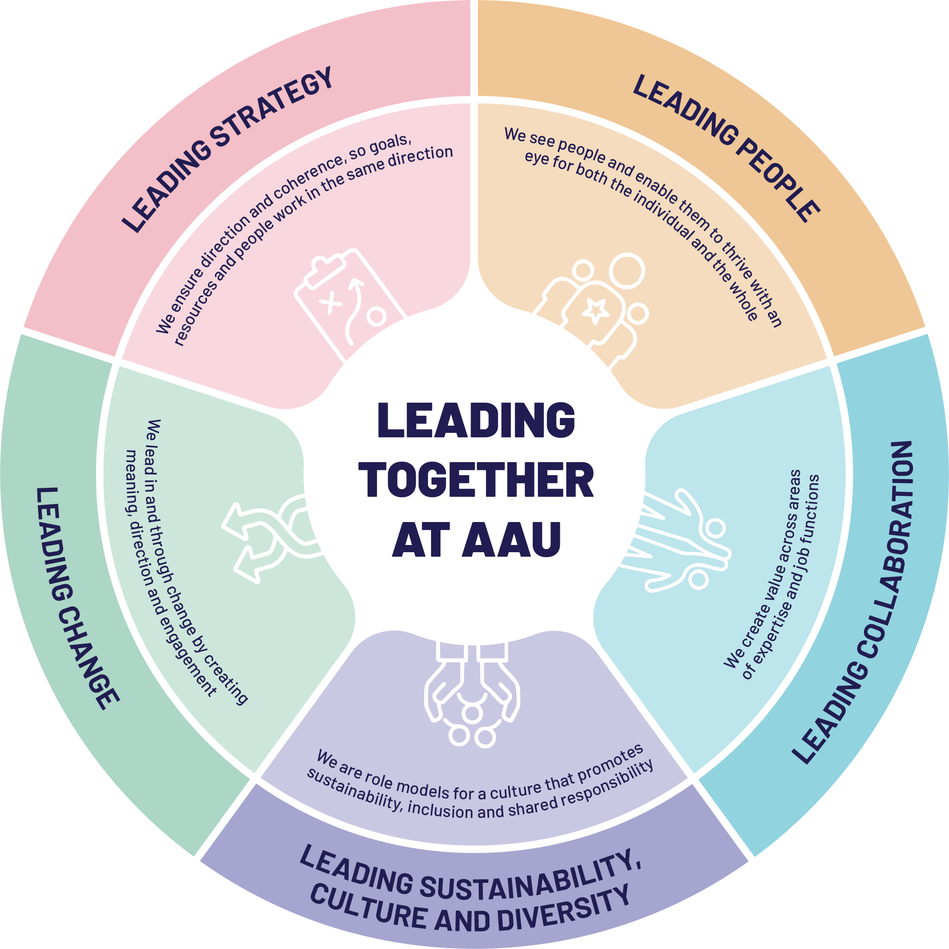
Notes:
The leadership principles consists of five guiding principles, each within its own leadership theme:
Leading people
Leading collaboration
Leading sustainability, culture, and diversity (this guiding principle and focus is new compared to the previous leadership principles)
Leading change
Leading strategy

Slide 5
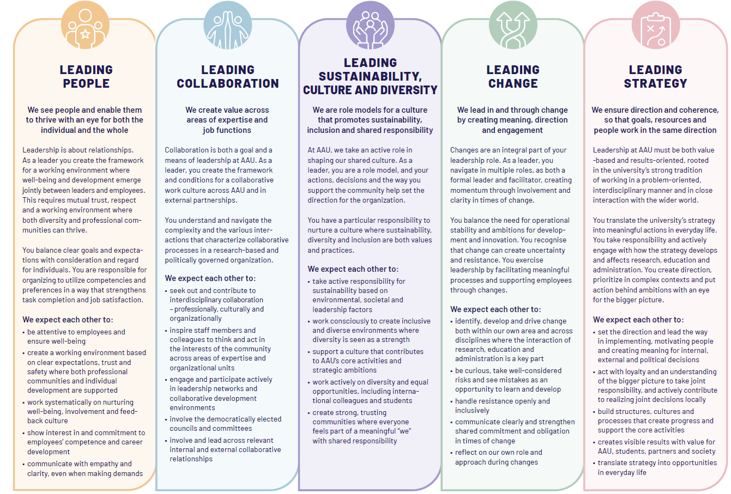
Notes:
For each guiding principle, expectations have been formulated for one another as leaders at AAU. These expectations are something both individual leaders and leadership teams must work with in their leadership practice. In today’s process, we will take our starting point in guiding principle XX.
Briefly frame the choice of guiding principle to be worked on before the process begins, and before the leaders themselves interpret the principle.
(As the facilitator, you define the 1–2 guiding principles the leadership team will work with during the process. To work with the remaining guiding principles, the process should be repeated at future leadership meetings. The suggested timeframe for the process is based on working with a maximum of two guiding principles.)

Slide 6


INDIVIDUAL REFLECTION
Read through the 1-2 selected guiding principles and reflect individually on the following questions:
What does this guiding principle mean to me as a leader?
How do I already see it in our practice?
Where do I see potential for development?
Write down your reflections.
5 MIN
Notes:
Set the reflection in motion and keep an eye on the timeframe. It is important that the individual reflection takes place in silence, allowing everyone the opportunity to form their own thoughts before a joint discussion begins. This provides the best foundation for everyone to contribute and be heard in the process.

Slide 7



DIALOGUE IN TEAMS/THE ENTIRE LEADERSHIP TEAM
Divide the leadership team into smaller teams (3-5 people)
Share your individual reflections and discuss:
  What common understandings do we have?
  Where do we differ?
  What does the guiding principle mean in our local context?
Divide the time equally if two guiding principles have been selected for this process
Questions for the group:
How are we already working with the guiding principle?
How can we as a leadership team work with this guiding principle?
What specific actions or measures can we take?
25 MIN
Notes:
If there are more than five leaders in the leadership group, it is recommended to divide the group into smaller teams to share reflections before conducting a joint summary in the next process step. Adjust the slide title according to how your process is structured.
Keep an eye on the timeframe and remind participants along the way to make sure they reach the questions within the group.

Slide 8

JOINT SUMMARY: ACTION PLAN
Each team shares 1-2 points or suggestions for specific actions
Joint summary and filling out the action plan template based on the following questions:
  What specifically will we work on?
  Who is involved/responsible?
  When should it happen?
  How will we work on it?
  Where should it happen in the organisation?
  How and when will we follow up?
15 MIN
Notes:
Choose one of the two processes for the joint summary (slide 8 or 9) and use only the relevant slide.
Once the groups have shared their key points and actions, you as the facilitator guide the group into a discussion of the questions in the action plan, while you or someone in the group ensures that concrete agreements are noted in the action plan (see slide at the bottom under materials).

Slide 9
JOINT SUMMARY
YOUR UNDERSTANDING OG THE LEADERSHIP PRINCIPLES
Each team shares 1-2 points about their understanding of the guiding principle in your leadership context or suggestions for specific actions
Together, you will document your translation of the leadership foundation in the template.
15 MIN
Notes:
Choose one of the two processes for the joint summary (slide 8 or 9) and use only the relevant slide.

Slide 10
NEXT STEP
Notes:
This is the first step in translating the leadership principles into your practice. The leadership team will carry the dialogue forward and continue building on it in upcoming leadership meetings.
Summarize what the next steps are for the leadership team in the work of the leadership principles.

Slide 11
REFLECTION SHEET FOR THE LEADERSHIP PRINCIPLES
Notes:
Sheet for A3 print for individual reflection

Slide 12
ACTION PLAN FOR WORKING WITH THE LEADERSHIP PRINCIPLES
What specifically will we work on? | Who is involved/responsible? | When should it happen? | How will we work on it? | Where should it happen in the organisation? | How and when will we follow up?
Notes:
Template for Summary Process A – to be completed digitally here or in the interactive PDF available on the website with the leadership principles.

Slide 13
Fill in here
Fill in here
Fill in here
Fill in here
Fill in here
Notes:
Template for Summary Process B – to be completed digitally here or in the interactive PDF available on the website with the leadership principles.

