Slide 1


Aalborg University Principles for Problem- and Project-Based Learning
INSERT NAME & DATE

Slide 2
Aalborg University Principles for Problem- and Project-Based Learning
Problem orientation
Project organisation
Student-directed
Collaboration
Process orientation
Exemplarity
Notes:
We found that it is a shared goal that our students learn to investigate and understand problems in terms of all their dimensions, relevant theoretical perspectives and empirical lenses. So rather than "base" the work on a "given" problem, students learn to analyse and formulate problems.
In an effort to be inclusive towards both the actual practices and also needs of different students, we found that it is not so much the group which is central as it is the project organization which entails collaboration not only within the group but also outside the group.
We find that semesters are designed for synergy and balance between activities and that we have a shared responsibility for succesful outcomes even when we take the backseat as supervisors. Not just "ansvar for egen læring" but offering support and allowing students to make difficult and important decisions.
We see that progression and succesful oucomes also hinges upon development of social skills and structuring skills. And we see that while the project organization offers a focused and results oriented frame, failures and conflicts can arise and should be accommodated for as they also represent parts of the learning journey when we focus on the process also and not just the result.
Forklar, hvad arbejdsgruppen har vægtet I revideringen (fx introduction), forklar materiale tilgængeligt på bordene – onepager, folder, dilemmaeksempler
Previous version:
Problemet som udgangspunkt
Projektorganisering i grupper
Projektet understøttes af kurser
Samarbejde – gruppe, vejleder, eksterne parter
Eksemplaritet
Ansvar for egen læring

Slide 3

Aalborg University Principles for Problem- and Project-Based Learning
Aalborg University offers a wide range of degree programmes that feature engaging, innovative teaching and learning approaches grounded in the university's pedagogical principles for problem- and project-based learning. These principles are rooted in a longstanding tradition and are recognised internationally. They form the foundation of Aalborg University's pedagogical model, which supports students' academic development and outcomes. This model is put into practice through various learning approaches, including teacher-directed courses, case-based learning and fully student-directed project work. The principles are understood as pedagogical values and points of orientation, and they are interpreted and applied differently in the development, organisation, and execution of learning activities across the degree programmes. While there are differences across degree programmes in how the principles are put into practice and in the emphasis placed on individual principles, they are all reflected in the programme as a whole.
Central to the principles is problem-oriented project work, which supports students’ interest-driven, in-depth study, independence and collaboration. A distinctive feature of Aalborg University’s application of these PBL principles is the combination and variation of teaching and learning approaches across semesters, which best support students’ personal and academic development. The university holds a considerable responsibility in creating favourable conditions for academic development, but the work must be done by the students themselves, together with others.
Aalborg University's pedagogical model is based on the premise that students learn best by actively applying research-based theories and methods to real-world problems. At the same time, the model supports the development of students' process-oriented competencies in communication and collaboration, and students learn to work analytically and with a focus on results. The distinctive competencies that students develop through the problem- and project-based learning model are strengthened through progressively more challenging learning objectives across semesters. For the university as a whole, the PBL principles involve interaction with the wider world, through which students become co-creators of new knowledge and change.

Slide 4

Problem orientation
Problem-oriented work is based on a problem that reflects students' interests and is academically and societally relevant. Problem orientation involves a process in which students identify, formulate and address a current, pertinent problem in its context, drawing on relevant disciplinary and interdisciplinary knowledge. The problem serves as the focal point guiding the student's learning process.
Through problem-oriented work, students are challenged to understand broader contexts, analyse practice through theoretical and empirical lenses, and develop proposed solutions.
Students, therefore, learn to adapt their knowledge, skills and competencies to new contexts and apply them in different situations. By engaging with the complexity of the situation, students develop critical reflection, curiosity, and engagement.

Slide 5
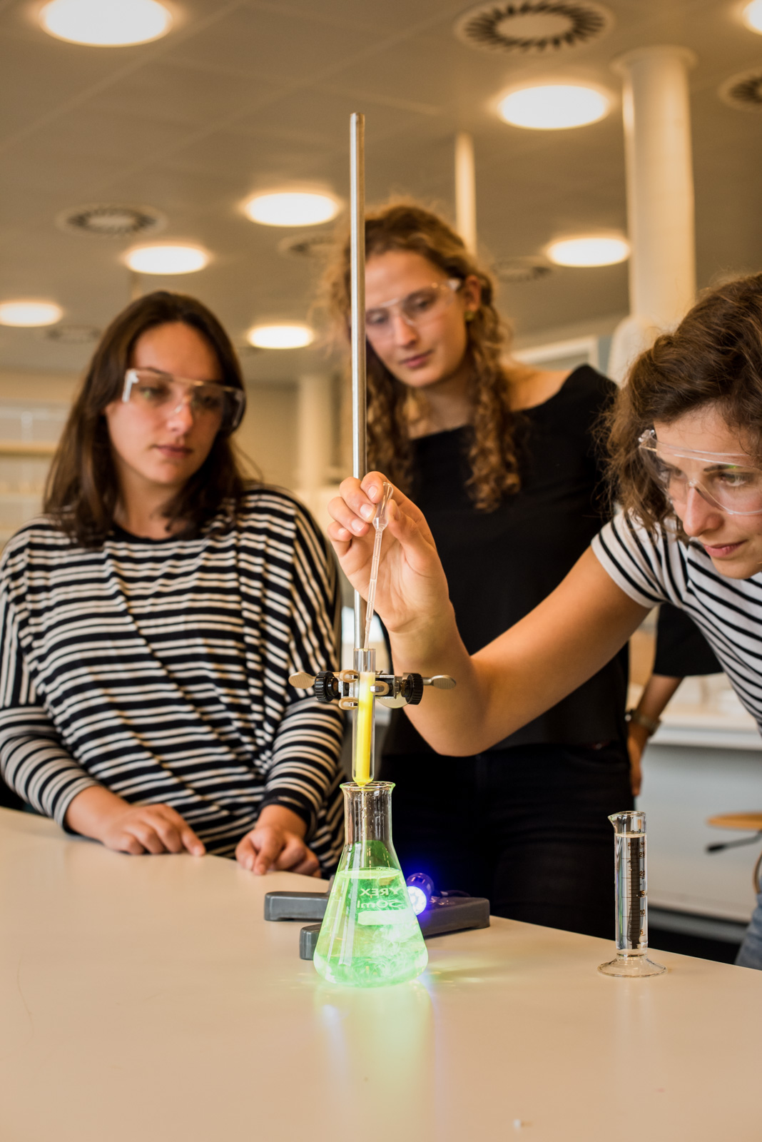
Project organisation
Project organisation, often in project groups, supports addressing complex questions and problems over a longer time frame. Project work allows for the development of holistic, nuanced solutions and perspectives on the problems through the project group's commitment and the exchange of diverse viewpoints throughout the process.
Project organisation entails a time-limited, results-oriented, and social framework for the learning process, where students can collaborate and co-create based on a shared problem formulation. This establishes a natural focus on both individual responsibility and the group's collective responsibility for the shared product.
The interaction and balance between courses, cases, and project modules in specific semesters and throughout the programme support the link between theory and practice. In this way, theories and methods are applied to the chosen problem formulation in a relevant and innovative manner.

Slide 6
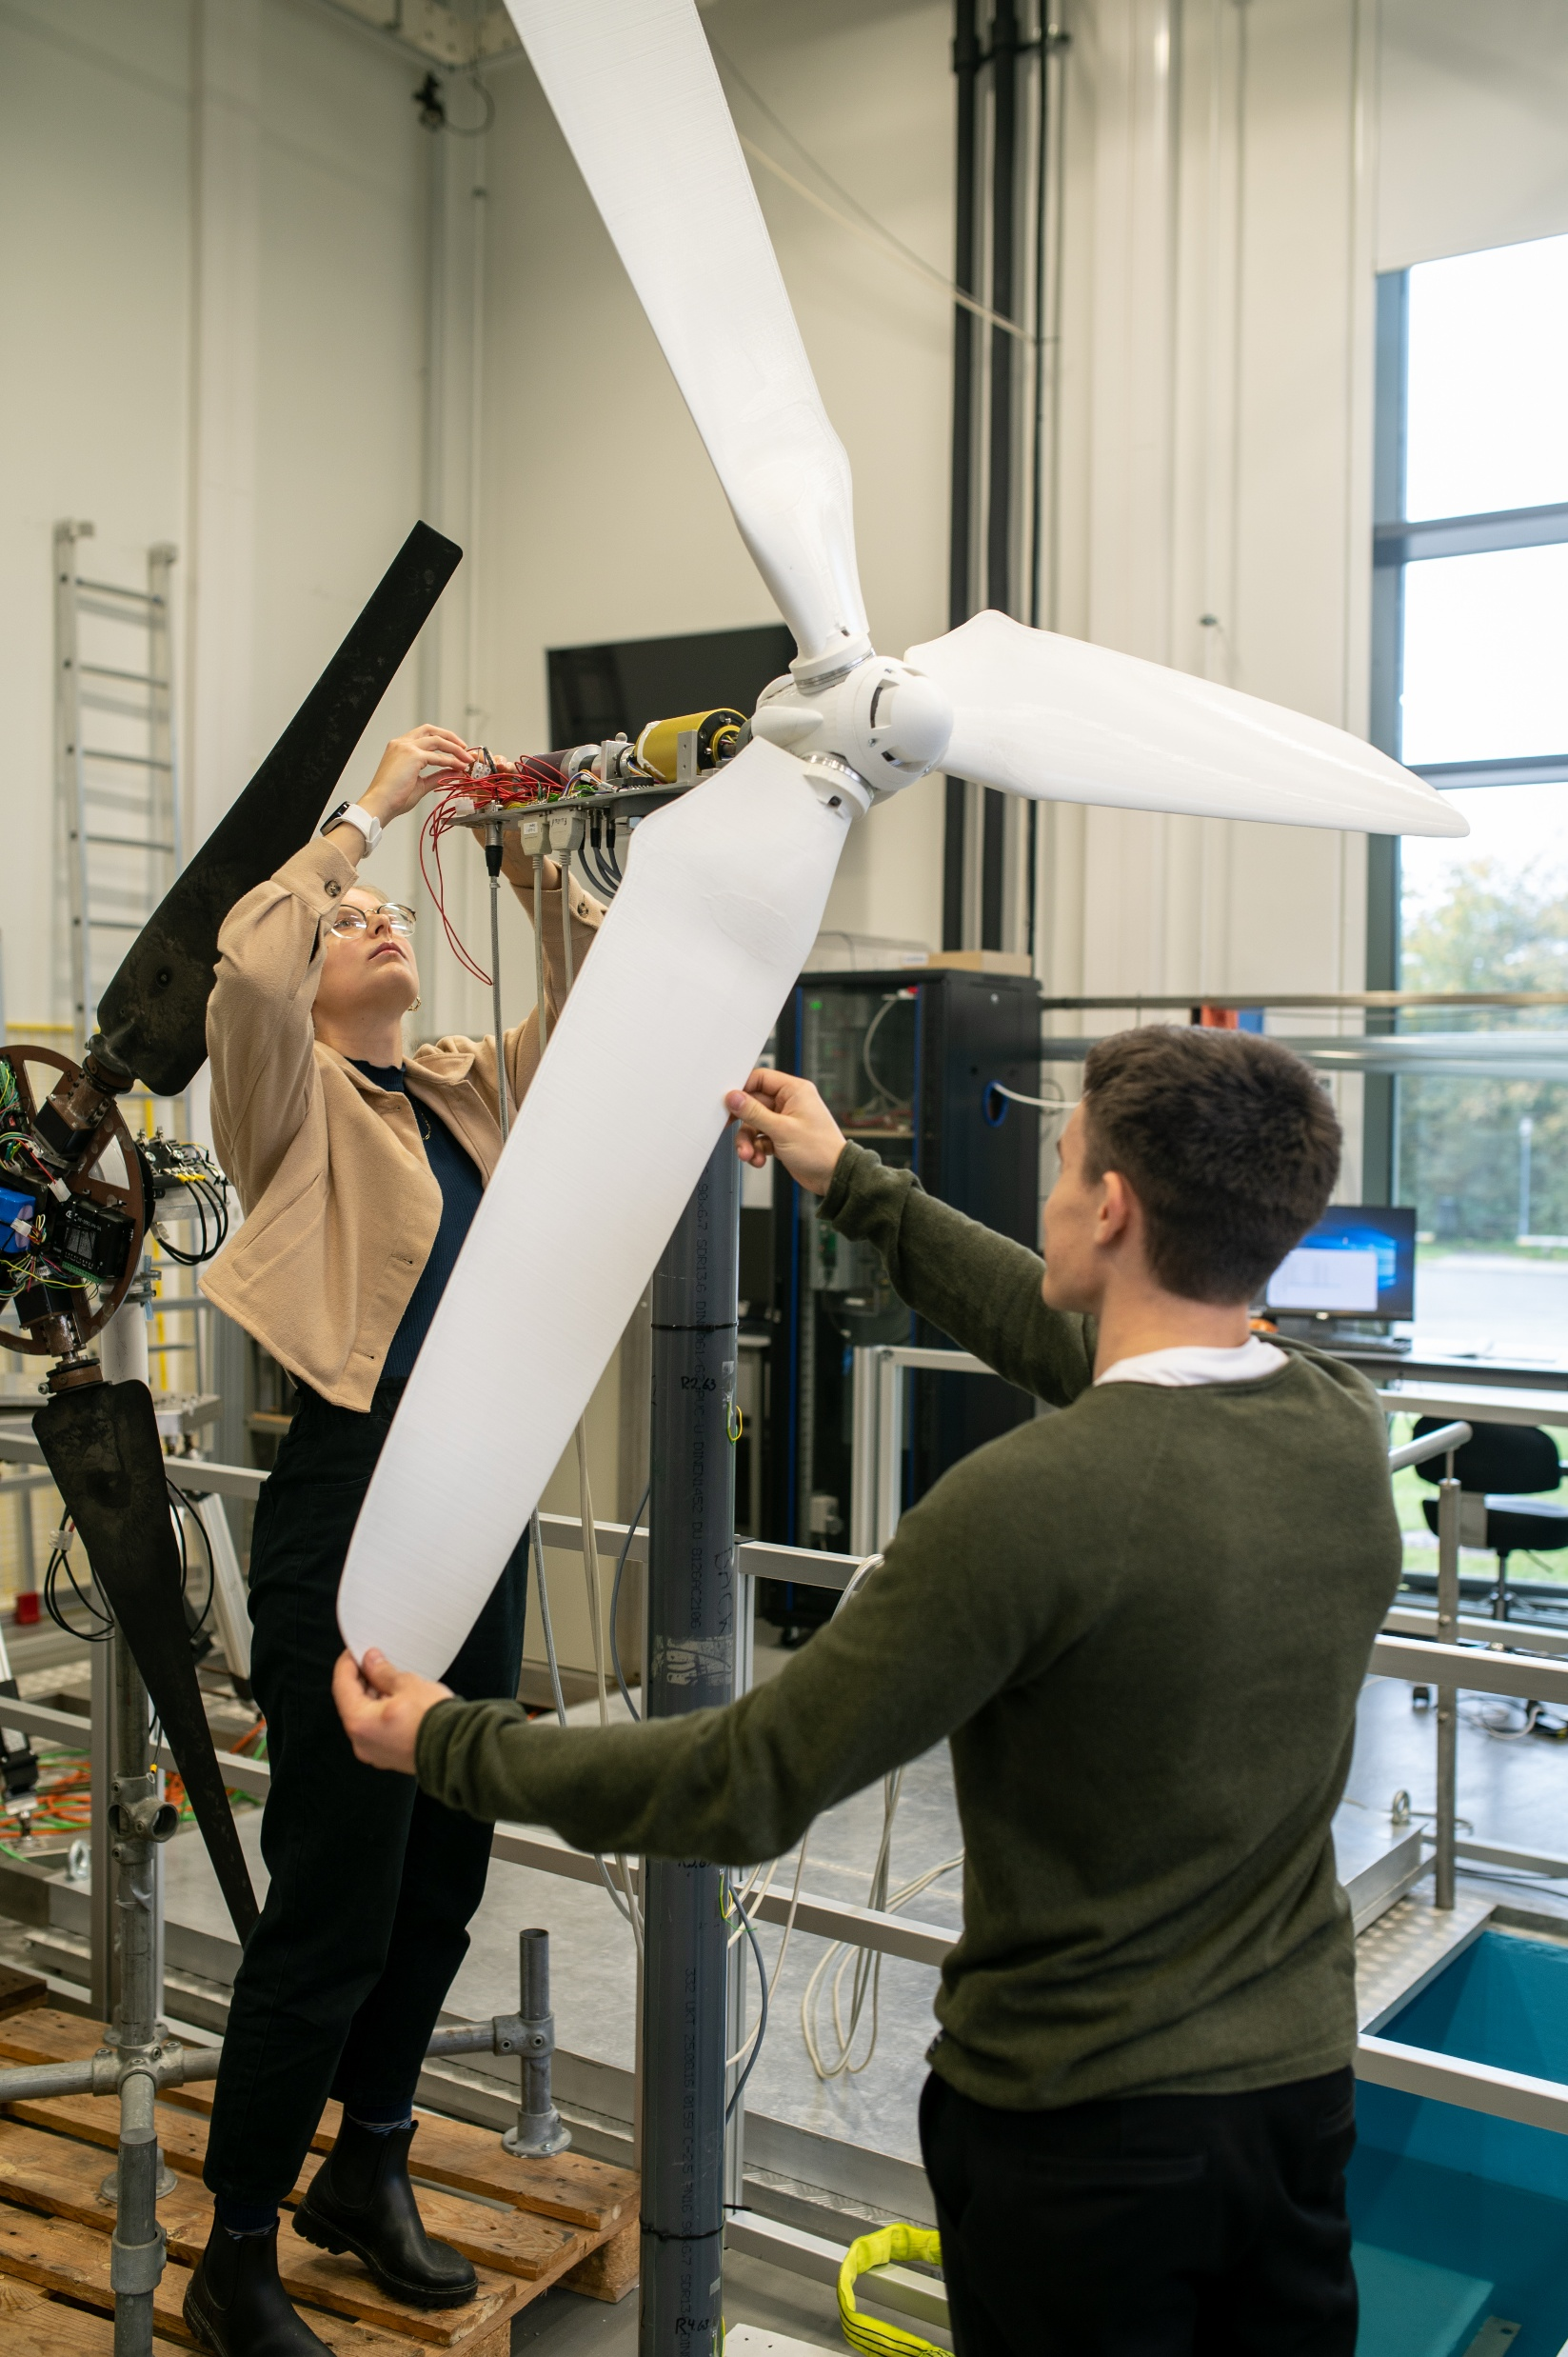
Student-directed
Programme activities can be either teacher-directed or student-directed, and both are vital. In student-directed activities, students step forward, are empowered to make their own decisions, and assume responsibility for key choices within the broader thematic framework. This is particularly evident in problem-oriented project work. The lecturer or supervisor then assumes a different role in student-directed activities, offering support through academic and process feedback. Students assume responsibility by engaging in structured or self-directed learning processes to maximise their learning outcomes.
Student-directed programme activities support students’ development of independence, critical thinking, and a meaningful professional identity. Facing many options and needing to justify choices encourages students to think and argue independently, carve out their own paths, and receive input and feedback from peers, lecturers, and external partners.

Slide 7

Collaboration
Collaboration is a key requirement for learning when students participate in problem-oriented project work, case-based learning, and course activities. Students support one another in developing new understandings and practices within project groups, study groups, and across the cohort.
Students collaborate within a learning community that includes fellow students and, when appropriate, external partners. A learning community relies on mutual commitment, in which students agree on the conditions for their collaborative relationships within the project group, within the cohort, with the supervisor, and possibly with external partners. Mutual respect and an appreciation of diversity are important aspects of constructive collaboration.
The goal is to promote broad collaboration that improves students' learning and benefits the wider community. Collaboration can occur within a single discipline or across multiple disciplines, as well as between groups from one or more study programmes.

Slide 8
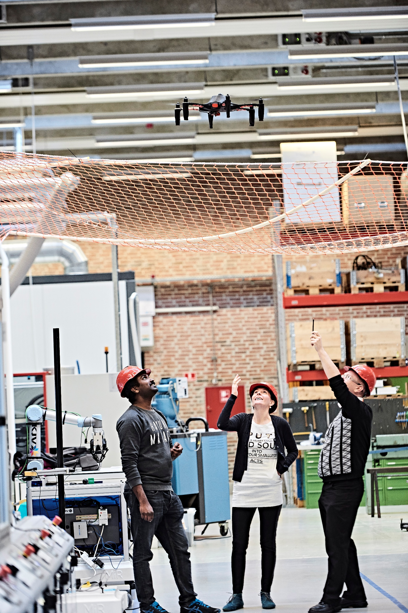
Process orientation
Process orientation refers to all the processes students and lecturers need to be aware of, support, and reflect on to complete the joint task and achieve the goal or product related to the course, case, or project. An important aspect of process orientation is reflecting on the work processes in which students and lecturers are involved. This includes knowledge sharing, shared decision-making, collective understanding, conflict management, academic discussions, coordination, and constructive feedback. As a principle, process orientation promotes both awareness of the process to improve the final product and helps students develop a deeper understanding of the process itself.
Lecturers, supervisors, and students all share responsibility for supporting a constructive process towards the goal or product in courses, case-based learning and project work. This also applies to constructive group formation processes. programme management also has a particular responsibility for supporting the group formation process. gruppedannelsesprocessen.
Process orientation is the foundation of an inclusive study environment that provides space to cultivate students' understanding of academic and personal differences, of their own strengths and weaknesses, and, not least, of openness to making mistakes and learning from experience.

Slide 9

Exemplarity
The principle of exemplarity supports students in acquiring knowledge, skills, and competencies that can be applied in broader contexts beyond the immediate teaching situation, case, or project work.
By starting with an example described in teaching or by independently working on a specific issue in their projects, students are challenged to engage with the complexity of the problem as a whole and to place the specific within a wider context.
In the process, the lecturer or supervisor supports students in developing broader conceptual understanding by tackling a specific problem and connecting it to general questions relevant to the field of study. In planning teaching, exemplarity involves choosing exemplary elements (theory, empirical knowledge, and methods) that represent the broader field.
Three criteria shape the exemplarity of examples and problems:
1) the proximity to students' horizon of experience and interests,
2) the potential to explore relevant societal as well as disciplinary questions, and
3) the potential to challenge students to cultivate critical thinking, envision a better world, and engage actively in changing it.

